Slide 2
Important Information About This E-Training Manual
Thank you for your purchase of this electronic version of the Wisconsin Pesticide Applicator Training Manual. An applicator using this manual is obligated to pay a training fee, just as they would when purchasing a print copy of the manual. The training fee supports education, outreach, and training materials for Wisconsin’s pesticide applicators. Each person wishing to become certified needs to pay the training fee.
After paying the training fee and receiving this e-training manual, we will send you an “E-Manual Training Registration Certificate.” You must present the certificate as proof of payment of the training fee when you take your certification exam. Exam proctors for the Department of Agriculture, Trade, and Consumer Protection (DATCP) will NOT administer the exam to anyone who has not paid the training fee.
Due to copyright restrictions, the electronic version of this document is for your use only, and may not be shared or duplicated in any way.
Navigating this E-Manual:
This manual contains hyperlinks to websites outside of the manual. Hyperlinks are indicated in BLUE. The links were current as of the publication of the manual, however, those URL addresses can change.
The manual also has internal links:
Clicking on headings and subheadings in the Table of Contents takes you to that page.
Clicking on italicized words takes you to the glossary entry for that word or phrase (note that not everything in italics is in the glossary, for example, titles of books or scientific names).
Clicking on page numbers in the Index takes you to that page number.
Opening the “Bookmark” icon on the left side of this PDF gives you bookmarks for the chapters and sub- sections of chapters.
If you’re viewing this e-manual on a computer, you can holding the “Alt” key and press the left arrow key to return to the page you were previously on (for example, if you clicked an italicized word on page 7, which took you to the glossary, Alt + left arrow returns you to page 7). On other devices, you might have a “back” key or other similar function.
Wisconsin Pesticide Applicator Training Program
Department of Agronomy / 1575 Linden Drive / Madison, WI 53706-1597
Phone: 608-262-7588 / Fax: 608-262-5217
Email: PATprogram@mailplus.wisc.edu Website: https://fyi.extension.wisc.edu/pat/
© 2020 Board of Regents of the University of Wisconsin System.
Send inquiries regarding permission for any use of this material to: Pesticide Applicator Training
Department of Agronomy 1575 Linden Drive
Madison, WI 53706

Slide 3
Wood Preservation
A Safe Use and Certification Guide for Wisconsin Pesticide Applicators
Commercial Category 7.4 7th Edition
January 2022
Steve Tomasko
Extension Senior Outreach Specialist Pesticide Applicator Training Program University of Wisconsin
Glenn Nice
Extension Program Manager Pesticide Applicator Training Program University of Wisconsin
Jeff Morrell
University Distinguished Professor Wood Science & Engineering Oregon State University

Slide 4
Training Material Information
Certification Exam Information
UW Pesticide Applicator Training Program
PAT is part of UW-Extension and produces educational materials to help you become a more
knowledgeable, safe and effective pesticide applicator.
The Wisconsin Department of Agriculture, Trade and Consumer Protection (DATCP) writes and administers pesticide certification exams and
enforces pesticide regulations.
How to Order Training Materials
To order manuals, online courses, or to sign up for one-day live training / review sessions go to the PAT store website (you will need a credit card):
PAT Store
To pay by check, go to the PAT website “ordering” page:
Download Order Form
Then download the “Commercial mail order form.” Mail back to us with your check. We can also send you this form upon request.
☞ Note: Private applicators wanting the General Farming training manual and/or live training need to contact their local county Extension office. You can find your local office here: Find Your County Office
How to Schedule Your Exam
Are you attending a PAT live training /review session?
▶ No need to schedule your exam—it will be given immediately following the session.
Studying the manual on your own? The preferred and quickest method is to go to DATCP’s online exam scheduling website
What to Bring to the Exam
▶ Photo ID (e.g., driver’s license), Social Security Number and your Training Manual.
▶ Calculator: You may use a calculator for the exam. However, you cannot use cell phone or programmable calculators.
Pesticide Database Searches
Want to find out your certification status or search for pesticides registered in Wisconsin? You can do that and more at this DATCP website:
kellysolutions.com/wi
Sorry, we cannot take credit card orders over the phone.
Contact PAT for Questions About:
Pesticide safety training issues or materials
▶ Phone: (608) 262-7588
E-mail: PATprogram@mailplus.wisc.edu
Website: PAT Website
Postal mail: PAT program
UW-Madison 1575 Linden Dr.
Madison, WI 53706-1597
Contact DATCP for Questions About:
Certification exam questions
Your certification status
Pesticide use and regulations
▶ Phone: (608) 224-4548
Email: DATCPpesticideinfo@wi.gov
Website: https://datcp.wi.gov/
Emergency Phone Numbers
For Human Poisonings ........... 800-222-1222 (Nationwide Poison Control) For Animal Poisonings ........... 800-224-4500 (Animal Toxic Response Team) For Pesticide Spills ................. 800-943-0003 (Wisconsin Spill Hotline)
January 2022
An EEO/Affirmative Action employer, the University of Wisconsin-Extension provides equal opportunities in employment and programming, including Title IX and ADA requirements.

Slide 5
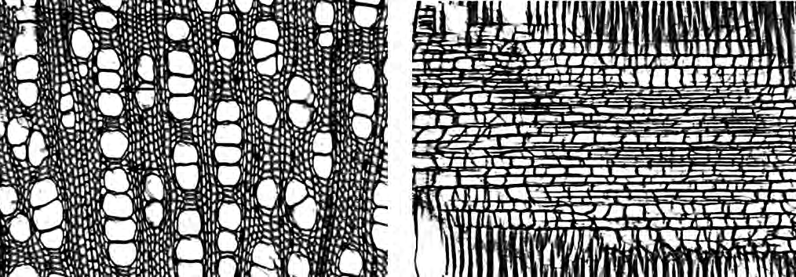
Wood Structure
Wood and its Pests
SECTION I
LEARNING OBJECTIVES
Describe the differences between softwoods and hardwoods. Identify the basic structure of wood and characteristics of the different parts. Explain how wood grows and how annual rings form. Define the terms earlywood, latewood, sapwood and heartwood. Explain the cellular structure of wood. Give reasons why wood varies in how easy or hard it is to treat. Explain how the differences in the cellular structure, and sapwood and heartwood, effect preserva- tive treatment.
Note: Words in italics throughout this manual are defined in the glossary.
Wood Structure Basics
I
n this chapter we will briefly describe the structural
leading because they do not reflect the actual hardness of the wood—the wood of a softwood species is not necessarily “softer” than that of a hardwood species. Rather, “softwood” is a general term for conifers, such as fir, pine, and spruce. “Hardwood,” on the other hand, refers to deciduous trees (i.e., trees that lose their leaves annually), such as oak, maple and aspen.
features of wood. Knowledge of wood structure is
useful in understanding how pests attack wood and
how such attacks may be prevented or dealt with.
Basic Anatomy of Wood
Wood is mostly made up of hollow, spindle-shaped
cells arranged paral-
lel to each other along the trunk of a tree (Fig- ure 1). When lumber is cut from the tree, the characteristics and ar- rangement of these fi- brous cells affect such properties as strength, shrinkage, and grain pattern of the wood as well as the penetration and retention of wood preservatives.
A cross section of a tree shows the following well-defined features, in order from the outside to the center (Figure 2):
Bark is the tough, exterior covering of tree trunks and branches. It consists of an outer, corky, dead part that varies greatly in thickness with the species and age of tree, and a thin, inner, living part.
The cambium lay- er lies between the bark and wood. It is the very thin (one cell layer thick) liv-
Those properties of wood differ between tree species, and es- pecially between soft- woods and hardwoods. Although commonly used, the terms soft- and hardwood are mis-
Figure 1: Wood may look solid, but viewed through a microscope, this section of woody tissue reveals the orderly layout of wood cells with lots of space. It’s through these cells that the tree transports water and nutrients. It’s also through these spaces that wood pre- servatives can move (Photo courtesy of USDA Forest Service, Bugwood.org).
WOOD STRUCTURE

Slide 6
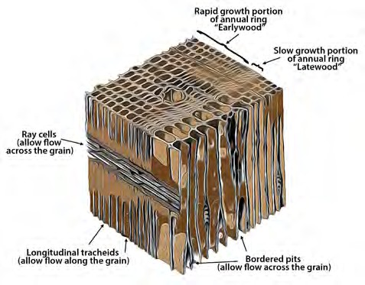
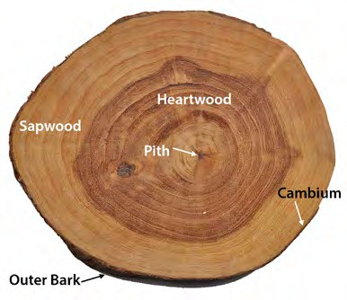
ing tissue that produces the growth of the wood.
Wood is the hard, fibrous substance comprising the largest part of the trunks and branches of trees.
trunk by counting these rings. If the diameter growth of trees is interrupted by drought or defoliation by in- sects, more than one ring might be formed in the same season. In such an event, the inner rings usually do not have sharply defined boundaries and are termed false rings.
In merchantable trees of most species, the wood is clearly differentiated into sapwood and heartwood.
The pith is the central strand of tissue in the cross section of a tree. Often darker in color, the pith rep- resents primary growth formed when woody stems or branches elongate.
Figure 3: Above is a diagram of a typical cellular structure of a softwood tree species.
Figure 2: This diagram shows the basic structure of wood. The bark protects the tree from injury and pests. The cam- bium is a thin layer of cells where growth occurs. Sapwood is located next to the cambium and functions primarily in the storage of food and the mechanical transport of sap. Heartwood consists of inactive cells that have been slightly changed, both chemically and physically, from the sapwood cells. (Text added to photo courtesy of Biswarup Ganguly, CC BY 3.0, Wikimedia.org).
Earlywood and Latewood
The inner part of the growth ring, formed first in the growing season, is called earlywood or springwood, and the outer part, formed later in the growing season, latewood or summerwood (Figure 3). The transition from early- to latewood can be gradual or abrupt, de- pending on the kind of wood and growing conditions at the time the wood was formed. In some species, such as maples and yellow poplar, there is little difference in the appearance of the earlywood and latewood.
Wood Growth
The inner part of the bark is called the cambium—this very thin layer of living tissue (only one cell thick) is where wood growth happens. Growth occurs when the cambium cells divide. New wood cells are formed on the inside of the cambium and new bark cells on the outside. These cells later die and comprise the bulk of wood—the sapwood, heartwood and outer bark. As those new cells form and the diameter of the woody trunk increases, they push outward, and the outer bark layers become stretched, cracked, and ridged in pat- terns usually characteristic of a species.
When growth rings are prominent earlywood differs markedly from latewood in physical properties. Early- wood is lighter in weight, softer, and weaker than late- wood. It shrinks less across and more lengthwise along the grain of the wood. Because of the greater density of latewood, the proportion of latewood is sometimes used to judge the quality or strength of wood.
Sapwood and Heartwood
Wood of all species is composed of two distinct parts
(refer back to Figure 2).
Growth Rings
With most species in temperate climates, there is suf- ficient difference between the wood formed early and that formed late in a growing season to produce well-marked annual growth rings (Figure 3). You can determine the age of a tree at any cross section of the
Sapwood is physiologically active while the tree is growing. It is where water and nutrients move through the tree. As the tree grows, new sapwood forms and the older sapwood becomes heartwood. Sapwood sur- rounds the heartwood, which is the inner, darker por-

Slide 7
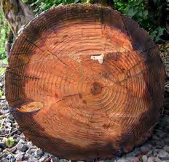
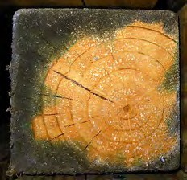
tion of the stem. Heartwood is composed entirely of dead cells where the tree deposits extractives (biologi- cal waste products).
naturally more susceptible to decay than before.
Wood Cellular Structure
Cells that make up the structural elements of wood are of various sizes and shapes and grow quite firmly to- gether. Dry wood cells can be empty or partly filled with deposits, such as gums and resins. A majority of cells are considerably elongated and pointed at the ends and are called fibers. The length of wood fibers is high- ly variable within a tree and among species. Hardwood fibers average about ¹/25 of an inch long; softwood fibers (also called tracheids) range from ⅛ to ⅓ of an inch long.
Wood and its Pests
SECTION I
These features result in two major differences between heartwood and sapwood: heartwood of some species has greater natural resistance to pests, but sapwood is easier to treat. Southern yellow pine has a lot of sap- wood, which is why it is easier to treat than Douglas- fir, which has only a thin layer of sapwood around the heartwood center.
The difficulty in treating heartwood is due to its cells being clogged, closing these pathways for preservatives to flow (Figure 4).
Basically, you can think of wood as a collection of elongated, hollow tubes arranged in a series of paral- lel circles along the length of the tree. Because of this structure, fluids move easier along, rather than across, the wood grain. Exposed end-grain provides openings for rapid movement of moisture deep inside large mem- bers. Preservatives will also move more easily along the wood grain. However, some flow (called transverse flow) across the grain is possible through ray cells and through openings between longitudinal cells (refer again to Figure 3).
Figure 4: After a treatment with wood preservative, round utility poles will have a uniform shell of treated sapwood (darker outer portion on left). However, sawn members will get good penetration of preservative where sapwood is prevalent but not where heartwood extends close to the edge (as on the right—lighter area indicates poor penetration in heartwood). (Photos courtesy of USDA Forest Products Laboratory).
Chemical Composition of Wood
Dry wood consists chiefly of the following substances, listed in decreasing order of amounts present: cellulose, lignin, hemicelluloses, extractives, and ash‑forming min‑ erals. The intimate physical, and perhaps partly chemi‑ cal, association of cellulose with lignin and the hemicel‑ luloses imparts to wood its useful physical properties.
The slower a tree grows, the more dense its heartwood. Therefore, the amount of heartwood will be propor- tionately greater than sapwood in a slow-growing tree, such as one from a dense virgin stand. Today, however, most virgin forests have been cut. Trees now grow in open stands, are fast growing, and, proportionately, have more sapwood. This mean that lumber today is
NOTE TO READER: As we discussed in the in- troduction of this manual, material on a shaded background such as this (or any material in the appendices) is not covered on the certification exam but is supplied as added reference material.
Effect of Wood Structure on Treatment
D
ifferences in the cellular structure between wood
This is another reason why different species and even dif- ferent parts of the same species of wood treat differently.
species, and between heartwood and sapwood
within a tree, are important considerations in
There are several reasons why woods vary greatly in their properties, and therefore in how they treat with preservatives. We discuss some of these below.
preservative treatment. As we mentioned, preservative enters wood through cells—specifically, through cell openings. The more openings there are and the bigger they are, the easier it is for wood to receive preservative.
WOOD STRUCTURE
ABC3

Slide 8
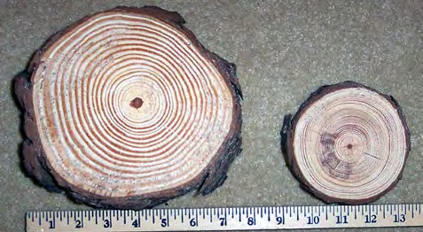
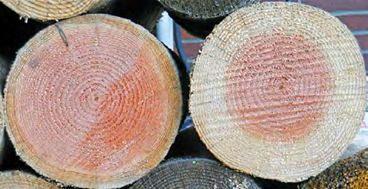
Differences Between Species
There are many different wood species, each with its own characteristics. For example, southern yellow pine and red pine are easier to preserve than Douglas-fir or hemlock. Likewise, western hemlock and western red cedar are more easily penetrated by preservatives than are red and white spruces. You need to take these dif- ferences into account when treating the wood.
Growing Conditions
Growing conditions affect the properties of some wood species. In the western United States, for example, coastal Douglas-fir is easier to treat than interior Doug- las-fir. Also, whether the trees grew in the open or in mor shaded conditions and other factors can influence the growth rings (early- and latewood) and amount of sapwood compared to hardwood (Figure 5).
Post-Harvest Processing
How wood is processed after a tree is felled—especial- ly the extent to which it is dried—affects its properties. For example, Douglas-fir poles are commonly incised to increase preservative penetration.
Effect of Air and Water
Air in wood cells can be compressed and, to some ex- tent, replaced by penetrating preservative. However, air will ultimately be an obstacle to full impregnation of the wood because preservative cannot occupy space that is taken up by air that remains in the wood. Water inhibits penetration of preservative for the same rea- son—wood cannot be forced into cells or cell walls that are saturated with water.
Heartwood and Sapwood
The heartwood of most species is difficult to penetrate with preservatives, even under pressure. So, treatabil-
1
2
Heartwood
Heartwood
Figure 5: Although smaller in diameter, the longleaf pine on the right (in Image 1) is older with 43 annual rings com- pared to 20 for the tree on the left. The the younger tree grew more in the open while the older tree was shaded and grew slower. In Image 2 you can see how the propor- tion of sapwood to heartwood can vary within a species. Both the trees in Image 2 are Douglas-firs. You can see the wide variation of sapwood to heartwood between the two. (Photos courtesy of (1) David Stephens, Bugwood.org; (2) Oregon State University, Forest Research Laboratory).
ity of different species is largely a function of their sap- wood content. In some species even the sapwood can be difficult to treat.
Treatment Standards
Bincorporated into the treatment standards of the
most types of preservatives. Treated southern pine is used for nearly all types of treated wood applications.
ased on their cellular structure, wood species
groups or classifications have been developed and
American Wood Protection Association. (We discuss treatment standards in more detail in a gray box at the end of this chapter).
In the western U.S. and Canada, species most often treated are Douglas fir, ponderosa pine, and the Hem- Fir species group (predominately western hemlock with a lower proportion of true firs). With the possible exception of ponderosa pine, these species tend to be more difficult to treat with preservatives or are more variable in their treatability. Often they must be in- cised (small slits cut into the wood) to obtain adequate penetration. There is also a tendency to separate these species according to end use. Douglas fir is the pre-
The species group most often treated with preserva- tives in the U.S. is the Southern Pine species group. This group, which includes loblolly, shortleaf, slash, and longleaf pines, grows primarily in the southern and southeastern U.S. Southern pine trees are characterized by a large sapwood zone that is readily penetrated by
4
CHAPTER 1

Slide 9
dominant western species used for transmission poles and piles, while Hem-Fir and ponderosa pine are more often treated for use as lumber.
there is now increasing interest in treating these species when they are used in construction in areas of the U.S. with high termite hazard.
Wood and its Pests
SECTION I
Another major species group is the spruce-pine-fir (SPF) group. This group contains a large number of species that grow in the northern U.S. and Canada. Like the Hem-Fir group, these species tend to be dif- ficult to treat or to vary widely in their treatability. SPF species are widely used for construction framing, and
The use of treated hardwoods is largely confined to railroad ties and bridge timbers. Of the hardwood spe- cies, red oak, which grows throughout the eastern U.S., is the single most often used species.
More Wood Treatment Standards Information
NOTE: Before we begin this discussion, remember that information on a gray shaded background
such as this is supplied for reference only. You will not be tested on this material.
The desired end use of the wood determines the treatment specifications (standards). The standards include factors such as the species of wood, treatment method, preservative to use, and how much preservative needs to remain in the wood after treatment. For example, pest pressure is higher when wood is in contact with soil or water, so the wood would need greater protection from the pests. Therefore, it makes sense that pine used for marine pilings in southern waters would be treated to different specifications than pine used for above‑ground construction where it can be pro‑ tected from constant moisture and pests. The standards or specifications for treatment can come to you from several sources.
AWPA Standards
Many treatment plants treat wood products according to standards set by the American Wood Protection Association (AWPA). The AWPA is the principal standards‑writing body for methods, preservatives, and other technologies that protect wood and wood‑based products. Each year, the AWPA updates its Book of Standards. The book includes the Use Category Systems Standards U1 and T1 as well as other standards pertaining to the use of wood preservatives. To order a copy of the AWPA Book of Standards go to their website: https://awpa.com/standards.
Building Codes
The International Code Council–Evaluation Service (ICC–ES) provides another route for gaining building code ac‑ ceptance of pressure‑treated wood. Unlike AWPA, the ICC–ES does not standardize preservatives. Instead, it issues Evaluation Service Reports (ESRs) that provide evidence that a building product (such as a 2x6 treated with a particular preservative) complies with building codes.
Some commercially available waterborne wood preservatives are not standardized by the AWPA, but are used to treat wood to meet ICC‑ES requirements. In such cases, the preservative supplier will usually provide you with a manual that includes treatment specifications for you to follow to ensure that the treated wood will comply with building codes.
Customer Standards
In some cases, the treatment standards are provided by the customer. This is especially true with large customers that have very specific uses for the wood products. For example, a railroad company may have its own standards for treating crossties, while a utility company might specify how utility poles must be treated. The customer will typically base their requirements on AWPA Standards or ICC‑ES Reports.
A

Slide 10
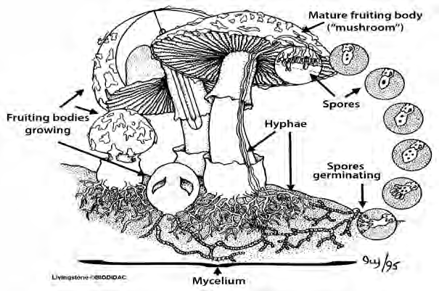
Pests of Wood
LEARNING OBJECTIVES
Identify which parts of wood (e.g., sapwood, cell contents) different groups of fungi feed on. Describe the damage caused by the different wood-destroying and wood-staining fungi. Describe conditions of the environment and wood that favor attack by termites and carpenter ants. Identify which insects use wood for food, shelter, or both. Describe the damage caused by different wood-boring beetles. List the major differences in feeding behavior between molluscan and crustacean borers.
Pest of Wood
W
e define a pest as any living organism that
As a wood treater, you should understand the habits and biology of wood-attacking organisms to properly prescribe treatment and to ensure proper performance of treated products. Proper identification of the pest is also important, because treatments (or knowing that no treatment is needed) varies depending upon the pest.
competes with humans for resources such as
food, fiber, wood, or shelter. Wood is subject
to attack and degradation by fungi, insects, and marine borers. These pests use wood for food, shelter, or both and in the process damage it.
Fungi
FHowever, unlike plants, fungi cannot
ungi are extremely small, plant-like
(in looks) organisms (Figure 1).
capture sunlight to make their own food. Instead, they break down organic matter (either living or dead) to feed themselves. Most of the mass of a fungus is composed of long, threadlike filaments called hyphae. The hyphae are invisible to the naked eye and absorb water and nutrients needed for growth and reproduction of the fungus.
The fruiting bodies (what we commonly call mushrooms) or masses of hyphae, col- lectively called “mycelium,” are the parts of fungi you are likely to notice.
Deadwood conks (Figure 2) and mush- rooms are easily visible examples of the fruiting bodies that produce the reproduc- tive spores. Spores are carried by water and wind and can infect moist wood dur- ing storage, processing, and use.
Figure 1: Shown above is a diagram of one kind of fungus. Fungi vary in what their fruiting bodies (i.e., mushrooms) look like or whether they even produce one or not. This diagram is intended to give you a basic idea of some of the structures of fungi. Fungi produce spores to reproduce. The hyphae (which are microscopic) extend into wood and release enzymes that break down wood. Although fungi may look more like plants, they are actually more closely related to animals. (Text added to illustration courtesy of Biodac.org).
8

Slide 11
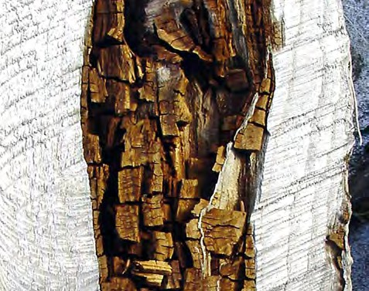
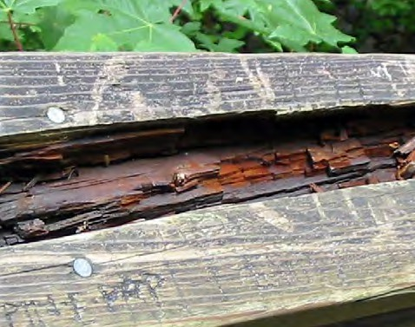
Figure 2: A “conk” is a term for a fungi fruit- ing body that grows out of the side of a tree. Like other mush- rooms, its purpose is to form and spread spores for reproduc- tion. Some conks, as seen here on this American beech, can be quite sturdy. This particular fungi is called an artist’s conk (Ganoderma applana- tum). (Photo courtesy of Joseph OBrien, USDA Forest Service, Bugwood.org).
wood decay by the brown-rot fungi can be identified by:
Wood and its Pests
SECTION I
The dark brown color of the wood,
Excessive shrinkage,
Cross-grain cracking, and
The ease with which the dry wood substance can be crushed into powder.
We can divide the many wood-inhabiting fungi into two major groups, depending on the damage they cause:
Wood-destroying (also called decay) fungi, and
Wood-staining fungi.
Wood-destroying Fungi
Wood-destroying fungi change the physical and chemi- cal properties of the cell walls of wood and, in doing so, reduce its strength. Most attack wood after the tree has died or been felled, but a few can attack a living tree that has been injured or weakened, by insects or physi- cal damage from storms.
Both the sapwood and heartwood of most tree species are susceptible to decay. Decay fungi can grow in the interior of the wood or appear on wood surfaces as fan-shaped patches of fine, threadlike, cottony growths or as rootlike shapes. The color of these growths range from white to dark brown. The fruiting bodies can be mushrooms, shelflike brackets, or structures with a flat- tened, crust-like appearance. Hyphae grow throughout the wood and digest parts of it as food. Over time, they destroy the strength of the wood. Decay will stop when temperature and moisture in the wood are unfavorable for fungal growth. However, decay can resume when temperature and moisture again become favorable.
Figure 3: Brown-rot decay often shows a brick-like decay pattern as seen in both the freshly cut log (top) and the railing (bottom). Brown-rot fungi are probably the most important cause of decay of softwood species used in above-ground construction in the U.S. as seen in railing. (Photos courtesy of (top) Susan K. Hagle, USDA Forest Service; and (bot- tom) USDA Forest Products Laboratory).
We can split wood-destroying fungi into three major categories: brown-rot, white-rot and soft-rot fungi.
White-Rot Fungi
Wood affected by white-rot fungi shows normal
Brown-Rot Fungi
Brown-rot fungi are able to break down cellulose in wood, which they use for food. This leaves a brown resi- due of lignin (Figure 3). The rotted wood can be greatly weakened even before decay is evident. The final stage of
shrinkage and usually does not collapse or crack across
the grain as with brown-rot damage (Figure 4). The wood loses strength gradually until it becomes spongy. White-rot fungi usually attack hardwoods, but several species also cause decay in softwoods.

Slide 12
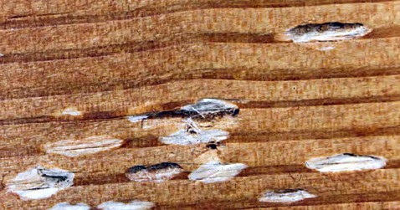
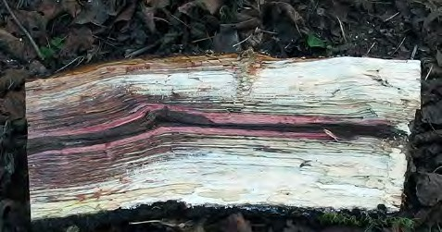
processing or seasoning. However, chemical stains can resemble fungi or mold stains. The worst chemi- cal stains are the brown stains because they downgrade lumber for some uses. They usually can be prevented by rapid air drying or by using relatively low tempera- tures during kiln drying.
Sapstaining Fungi
Sapstaining fungi penetrate and discolor sapwood. They can infect standing trees as well as sawlogs, lum- ber, and timbers soon after they are cut and before they can be adequately dried. Some beetles carry sapstain- ing fungi into trees, causing the wood to be stained be- fore the trees are cut (e.g., ambrosia beetles).
Some of the most common sapstaining fungi are the blue-stain fungi (Figure 5) that often produce a blu- ish growth deep within the wood. The blue color can completely cover the sapwood or might be visible as specks, streaks, or patches in varying shades of blue. Other sapstaining fungi species produce yellow, or- ange, purple, or red stains. Typical sapstain cannot be removed by brushing or planing.
Figure 4: White-rot fungi break down both lignin and cellulose and have a bleaching effect that can make the damaged wood appear whiter than normal. The top photo shows “white pocket rot.” On the bottom is a sec- tion of an oak trunk decaying by white rot fungus action. Decay has progressed from the right side, as it was the exposed end. Left end is freshly sawn. (Top photo courtesy of Clemson University - USDA Cooperative Extension Slide Series, Bugwood. org. Bottom photo courtesy of Auró, CC BY-SA 4.0, wikimedia.org/).
Soft-Rot Fungi
Soft-rot fungi usually attack green wood (wood that still contains tree sap) or other wood that has a high moisture content. The fungi cause a gradual softening from the surface inward that resembles brown rot. The affected wood surface darkens, and the outer ⅛ inch becomes very soft.
Wood-staining Fungi
Wood-staining fungi feed on contents of cells, rather than on cell walls, and so do not usually affect wood strength. They are generally unable to attack wood that is below 27% to 32% moisture content and, because cell contents are already gone in the heartwood, usu- ally only affect sapwood.
Figure 5: This ponderosa pine is showing the character- istic radiating pattern of blue stain fungus. (Photo courtesy of Sandy Kegley, USDA Forest Service).
Sapstain does not greatly affect the strength of wood. However, it spoils the appearance of lumber, lowers its grade, and reduces its commercial value. Sapstaining fungi can make conditions in the wood more favorable for wood-destroying fungi. They also increase the per- meability of the wood, causing areas of excessive pre- servative uptake.
There are two major categories of wood-staining fungi:
Sapstaining fungi, and
Mold fungi.
Chemical Stains
Sometimes wood stains are not caused by fungi at all, but are simple chemical reactions that happen during

Slide 13
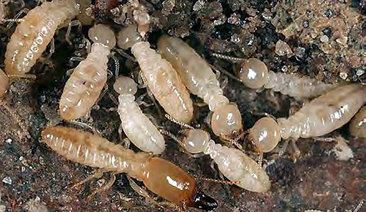
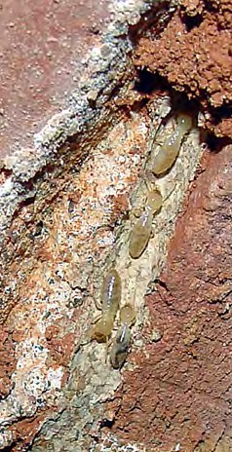
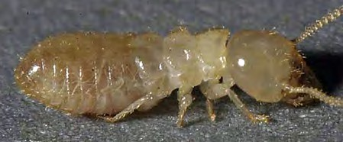
Mold Fungi
Mold fungi first become noticeable as green, yellow, brown or black fuzzy or powdery growths on the wood surface. You can usually brush, wash or plane the col- ored spores off. On open-pored hardwoods, however, the surface molds might cause stains too deep to be easily removed. Freshly cut or seasoned wood piled
during warm, humid weather can be noticeably discol- ored with mold in less than a week. As with sapstaining fungi, molds do not reduce wood strength, however, they can increase the capacity of wood to absorb mois- ture, which increases the potential of attack by decay fungi.
Wood and its Pests
SECTION I
Insects
SInsect attack is generally a minor contributing
Carpenter ants, and
Wood-boring beetles.
Termites
Termites use wood for food and shelter and are the most destructive of all wood-infesting insects. Only one spe- cies, the eastern subterranean termite (Reticulitermes flavipes), is native and found to any great extent in Wis- consin (Figure 6).
everal kinds of insects attack the wood of living
trees, logs, lumber, and finished wood products.
factor to the deterioration of dry wood, because most insects seek out wood that has already been damaged by high moisture levels. However, a number of wood-boring insect species can cause significant damage.
Damage Caused by Insects
Insect attack by termites or other wood borers will reduce the cross section of a wood member by either digesting or tunneling through the wood. With decay, there is usually a gradual transition from sound wood to punky wood to a total loss of wood fiber (a void). Un- like decay from fungi, insect damage tends to have an abrupt transition between affected and unaffected areas of the wood.
Subterranean termites live in colonies in the ground. They are most numerous in warm, moist soil that con- tains an abundant supply of food (cellulose) in the form of wood, paper, cardboard, or cotton. Most termite in- festations in buildings occur because untreated wood touches or is close to the ground, particularly at porch- es, steps, and terraces. Cracks or voids in foundations or concrete floors allow termites to reach wood that is not close to soil.
In terms of damage to wood in service, the most impor- tant groups of insects are:
Termites,
Although subterranean termites require a constant
A
C
Figure 6: (A) A group of workers and one soldier (dark head at bottom). (B) A single termite worker.
(C) Some subterranean termite species are more dependent on moisture and will build shelter tubes to travel between the nest and their food source. Here, the tube has been broken open revealing the work- ers underneath. Drywood termites do not build these tubes. (Photo credits: (A and B)
© Gary Alpert, Harvard Univer- sity, Bugwood.org; (C) © Micah B. Raub, Office of Pesticide Services, Virginia Department of Agriculture and Consumer Services).
B

Slide 14
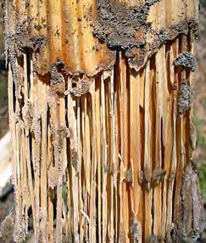
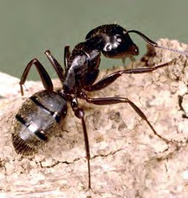
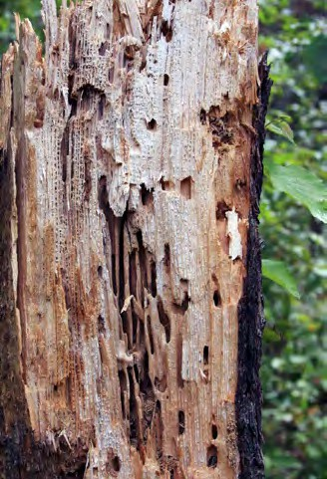
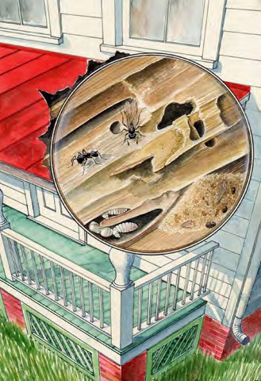
source of moisture to survive, they are able to live in dry wood (containing less than 20% moisture) by ob- taining moisture from the ground. This moisture is transported by the termites through flattened, earthen shelter tubes that serve as passageways from the soil to the infested wood (Figure 6).
in dry wood (containing as little as 5% moisture) with- out direct contact with the soil increases its menace. However, it reproduces slowly and does not destroy wood as quickly as the subterranean termite.
Although neither of the above species are found nat- urally in Wisconsin, they can, and sometimes are, brought in on wood products from elsewhere.
Carpenter Ants
Carpenter ants are medium to large, all black or black and red ants. Workers range from ⅜ to ½ inch long (Figure 8). Carpenter ants often get blamed for struc- tural damage problems. However, they do not eat or bore into sound wood. They only nest in wood that has already been softened or decayed by water damage and/or fungi and use it for shelter. They usually live in stumps, trees, or logs, but often damage poles or struc- tural timbers set in the ground.
Termite damage is of- ten not noticeable on the surface of attacked wood (Figure 7). Normally, termites attack the less dense springwood first and, when this is deplet- ed, feed on the denser summerwood.
Other Termites Dampwood termites are serious pests along the Pacific Coast. They do not require contact with the soil, but do need wood with a high mois- ture content.
Figure 7: Damage caused by termites after only 6 months of soil contact in Louisiana. (Photo courtesy of USDA Forest Products Laboratory).
Their tunnels can extend into dry wood, but the ants require high humidity in their nesting area. Left un- checked, the ants will enlarge their tunnels to the point where wood strength is impaired and replacement or extensive repairs will be required.
Wood-boring Beetles
Many species of beetles feed on wood. Some feed only on dead or dying trees and cannot reinfest sound, sea-
Drywood termites are not found naturally in Wis- consin. The termites enter cracks and crevices in dry, sound wood. The ability of the drywood termite to live
2
3
Figure 8: (1) A worker car- penter ant. (2) Carpenter ant damage to a tree showing the typical galleries the ants cre- ate. The galleries they make are large, smooth, and, un- like those of termites, free of refuse and powdery wood. (3)
An illustration of the carpenter ant life cycle and damage they can do to finished wood. They can attack elevated portions of buildings, such as windowsills and porch columns if that wood has been weakened by moisture and/ or fungi. (Photos and illustration courtesy of (1) Clemson University - USDA Cooperative Extension Slide Series; (2) Steven Katovich, USDA Forest Service; (3) Art Cushman. All from Bugwood.org).
1

Slide 15
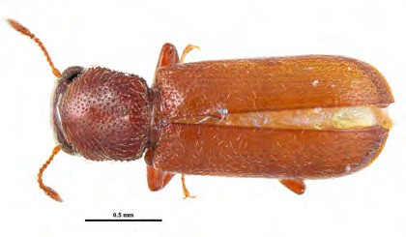
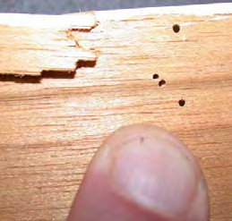
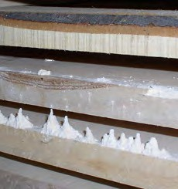
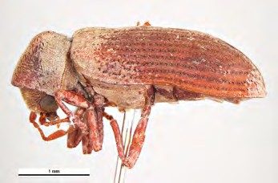
soned lumber. Other species can and do destroy struc- tural timbers, fine furniture, flooring, and other wooden objects by repeatedly attacking, and breeding in, wood.
of both softwoods and hardwoods, causing damage similar to that caused by powderpost beetles. Despite its name, this beetle also attacks structural timbers, plywood, and other seasoned wood products provided their moisture content is near or above 15%. Larvae grow more rapidly in wood infected with soft-rot and white-rot fungi and where high humidity and low max- imum temperatures prevail.
Wood and its Pests
SECTION I
Powderpost Beetles
True powderpost beetles are second to termites in eco- nomic importance among wood-infesting insects (Fig- ure 9). Their name refers to the extremely fine, flour- like fecal matter that they push out of infested wood. These beetles attack only dry, seasoned hardwoods, with most infestations occurring in sapwood. They use the wood for both food and shelter.
Roundheaded Borers
There are many species of roundheaded borers, most of which attack only dead or dying timber or recently cut logs (Figure 10).
Adult females lay eggs in the surface pores of wood. Larvae hatch out of the eggs and tunnel through the sapwood, usually along the grain. When they complete development, adults emerge from the wood through small (¹/16-inch) holes that are the tell-tale signs of pow- derpost damage. It will normally take years for serious structural damage to occur from powderpost beetles. However, cosmetic damage can occur in wood prod- ucts such as furniture, tool handles, picture frames, and gun stocks.
Flatheaded Borers
Flatheaded borers infest live trees as well as recently felled or dead, standing softwood trees (Figure 11). They can cause considerable damage in rustic struc- tures and some manufactured products by mining into sapwood and heartwood. Typical damage consists of rather shallow, long, winding galleries (tunnels) that are packed with fine powder.
Common Furniture Beetle
The common furniture beetle, also known as the ano- biid powderpost beetle (Figure 9), infests sapwood
Ambrosia Beetles
Ambrosia beetles tend to attack green wood and de- grade wood principally through staining. The beetles cultivate and feed upon fungi that they introduce into
1
2
3
Figure 9: Here are just two examples of the many beetle species of insects known as powderpost beetles. (1) Lyctids are often called “true pow- derpost beetles.” (2) Some typical damage these beetles do. (3) Loose powder is often the first noticeable sign of a powderpost beetle problem. You can find the powder on flooring, in dresser drawers, on furniture, or | 4
underneath infested beams. (4) The common name “anobiids” refers to another group of powderpost beetles, which includes the common furniture beetle shown here along with (5) its typical dam- age. (Photo credits: (1 and 4) Pest and Diseases Image Library, Bugwood.org; (2) UW-Madison Dept. of Entomology; (3) Stan Lebow, USDA Forest Products Laboratory; (5) Gyorgy Csoka, Hungary Forest Research Institute, Bugwood.org).
5

Slide 16
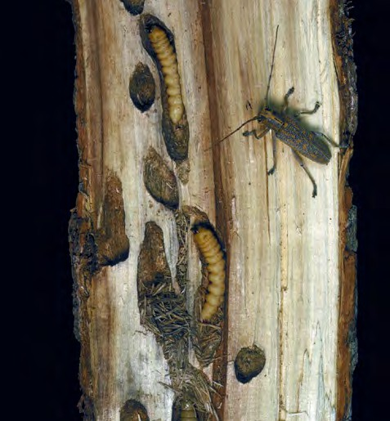
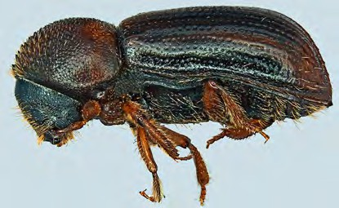
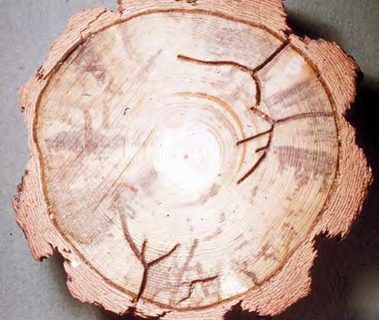
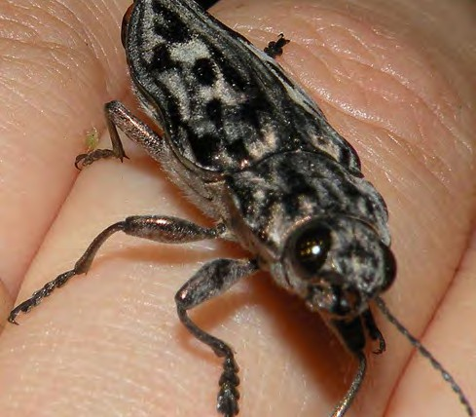
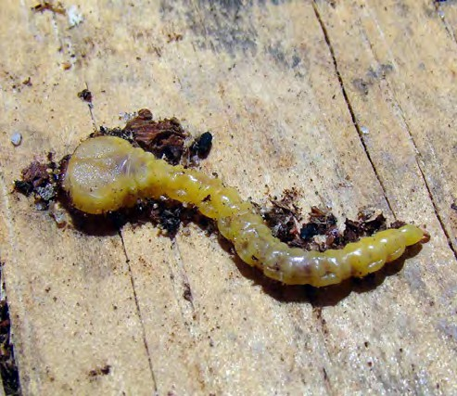
Figure 10: This photo shows larvae, pupa, an adult and damage of one species of roundheaded borer: the pop- lar borer (Saperda calcarata) on an eastern cottonwood. (Photo courtesy of James Solomon, USDA Forest Service, Bugwood.org).
their galleries (Figure 12). They use the wood principal- ly for shelter, deriving no nourishment from the wood itself. The adult beetles bore across the grain of the wood; accompanying the galleries is extensive staining caused by the fungus. Ambrosia beetle damage gener- ally does not seriously weaken wood, but the staining lowers the value of products made from the wood. The beetles will attack both hardwoods and softwoods.
Figure 12: There are many species of ambrosia beetle. Shown here is the striped ambrosia beetle (Trypodendron lineatum). On the bottom are galleries caused by the beetle in a ponderosa pine also showing blue stain fungi staining 2 weeks after attack. (Photos courtesy of (top) Steven Valley, Oregon Department of Agriculture; (bottom) Wayne Brewer, Auburn University. Both from Bugwood.org).
Figure 11: On the left is a large flat-headed pine heartwood borer (Chalcophora virginiensis) and on the right is a flatheaded or metallic wood borer larva. If larvae were present in a tree when it was milled into lumber, adults might emerge from the wood within the first 2 to 3 years after new construction. However, the insects are incapable of reinfesting seasoned wood. (Photos courtesy of (left) Jessica Louque, Smithers Viscient; (right) Rebekah D. Wallace, University of Georgia. Both from Bugwood.org ).

Slide 17
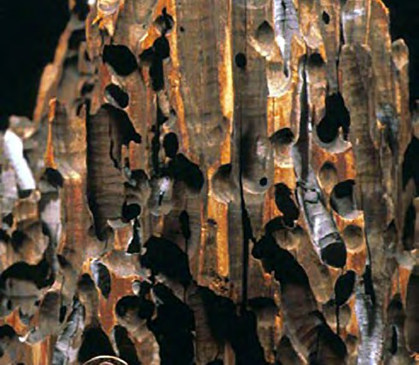
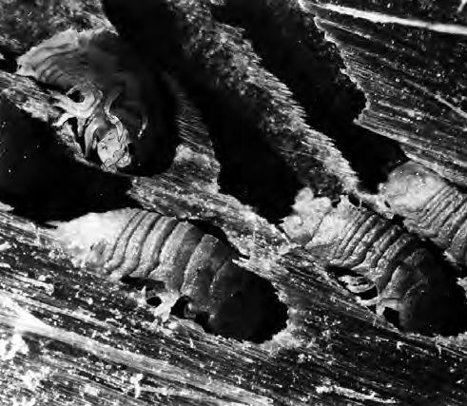
Marine Borers
Wood and its Pests
SECTION I
MThey attack any wood between the water line
animal grows, it enlarges its burrow to accommodate its wormlike body and becomes entrapped in the wood for the rest of its life. In less than a year, a timber can be completely honeycombed and its structural strength greatly reduced.
Crustacean Borers
Unlike shipworms, crustacean borers do not imprison themselves in attacked wood. Also, their burrows are much smaller than those of molluscan borers and their galleries are seldom deep in the wood. Damage caused by crustacean borers is less spectacular and slower to develop than that caused by molluscan borers.
arine borers are wood-boring marine animals
that live in brackish and salt water (Figure 13).
and mud line. No wood is known to be naturally immune. Marine borers can cause extensive damage to marine pilings, wharf timbers, and wooden boats. In the United States, they are especially active in the warm waters of the Pacific, Gulf, and South Atlantic coasts. There are two major groups of marine borers:
Molluscan borers, related to oysters and clams; and
Crustacean borers, related to lobsters and crabs.
Molluscan Borers
The free-swimming larvae of shipworms, or pile- worms, attach themselves to wood and bore into it, making minute holes in the surface of the wood. As the
Figure 13: On the left is boring damage done by a shipworm (Teredolites) in a modern wharf piling. On the right is a wood-boring isopod or crustacean borer (Limnoria lignorum). (Photos courtesy of (left) Wilson44691, Public Domain, wikimedia.org; (right) NOAA Central Library Historical Fisheries Collection; Smithsonian Institution).

Slide 18
Pesticides
LEARNING OBJECTIVES
Define the word pesticide and explain how the word differs from specific types of pesticides. Contrast the difference between organic and inorganic pesticides. Explain how general characteristics of pesticides (e.g., selectivity, persistence, etc.) can affect the pesticide’s performance and potential to cause environmental harm. Explain the difference between the different types of pesticide names. Outline the uses, effects on treated wood and health concerns for the wood preservatives listed in this chapter. Describe which fumigants you may use to treat wood when certified in this category.
About Pesticides
SECTION II
What is a Pesticide?
Arectly control pest
just touched on—pesticides are grouped according to the types of pests they man- age—insecticides, rodenti- cides, etc.
pesticide is any sub-
Examples of Specific Pesticide Types
stance used to di-
populations or to prevent or reduce pest damage. Not all
Pesticide Group
Avicide Fungicide Herbicide Insecticide Piscicide Rodenticide
Pests Controlled
Birds Fungi Weeds Insects Fish Rodents
pesticides actually kill the target pest— some might only inhibit its growth, repel it, or reduce its capacity to reproduce.
We can also group pesticides based on some basic chem- istry. In this way we can divide pesticides into two main groups: organic and in- organic compounds. A third group of pesticides consists of natural disease-causing agents called microbials, but these are not much used in structural pest control.
This list does not include those chemicals which, al‑ though legally defined as pesticides, are either not normally used as pest control agents (e.g., plant growth regulators, defoliants, desiccants) or are not directly toxic to the pest (e.g., attractants, repellents).
Many people mistakenly use the words “insecticide” and “pesticide” interchangeably. However, the word “pesti- cide” is a broad term that covers many substances— insecticides are just one specific type of pesticide. The “cide” part of the word comes from Latin meaning
Note: Just another reminder that information on a gray shaded background such as this (or information in the appendices) is not covered on the certification exam.
Organic Pesticides
In this manual when we say
organic pesticides, we use
“to kill.” Therefore, a pesticide kills pests—a broad category because those pests could be insects, weeds, fungi, mice or other critters we consider pests. If we are trying to control weeds, we would use an herbi- cide. For fungi, we use a fungicide and insecticides are
the word “organic” the same way a chemist would. To
a chemist, organic means the compound contains the element carbon. Do not confuse the term organic, as we use it here, with “organic farming,” which often means farming without using synthetic (man-made) pesticides.
aimed at insects. All of these are pesticides under the definition stated above. These are just three examples of the many types of pesticides in use today.
Ways to Group Pesticides
Pesticides are grouped or classified a number of differ- ent ways. Probably the most common way is one we
Most pesticides used today in agriculture and home and structural pest control are organic compounds. A few organic pesticides are either derived or extracted directly from plants (e.g., rotenone). Most, however, are synthetic (or man-made) compounds. They are often

Slide 19
very effective and some are quite specific in their ac- tivity. They have, however, been the principal focus of health and environmental concerns and are the pesti- cides most commonly associated with problems of pes- ticide use and misuse.
rates, copper and sulfur. They are often toxic to a wide range of organisms, a characteristic often not desirable. Inorganics were the most important of the early pesti- cides. The use of several inorganics has been banned or severely curtailed because of health and/or environ- mental concerns. Today, inorganics are used primarily to control plant diseases, as wood preservatives and to control algae.
Inorganic Pesticides
Inorganic pesticides are derived from minerals that occur in nature. Common inorganic pesticides are bo-
General Pesticide Characteristics
S
ome general characteristics of pesticides and ter-
others. The benefit of using selective pesticides is that they may not harm nontarget organisms such as ben- eficial insects (natural predators and parasites of pest species).
Persistence
Pesticides vary in their persistence, or how long they remain active to control pests. Persistence is also re- ferred to as residual activity. Pesticides with long a long residual—highly persistent—can control pests for months or even years. However, some break down very quickly into nontoxic by-products—these are the short- term or nonresidual insecticides.
minology are important in understanding how to
best choose, use and avoid problems with the use
of pesticides. We also cover some of these same and other characteristics in the chapter, “Pesticides in the
Environment.”
Selectivity
Pesticides vary in their selectivity. Selectivity refers to how broad, or narrow, a range of pests a particular chemical will kill. Pesticides are usually characterized as broad- or narrow-spectrum.
Broad-spectrum pesticides
Broad-spectrum pesticides are useful when several dif- ferent kinds of pests are a problem. For example, some broad-spectrum insecticides kill most insects it comes in contact with. Most wood preservatives are broad- spectrum.
A benefit of highly persistent pesticides is that they can control pests for a long period of time. However, that can also can lead to many problems. The longer a pes- ticide stays in its active form, the longer it has to move off the target site and contaminate the environment, get into the food supply, and harm nontarget organisms.
Narrow-spectrum pesticides
Selective, or narrow-spectrum, pesticides kill only a few, usually related, kinds of pests without harming
Many wood preservative pesticides are highly persis- tent.
The Naming of Pesticides
Treferred to by a number of different names (Figure
he naming of pesticides can be confusing. We
Trade Names
Manufacturers generally give one or more specific names to each different formulation of a particular ac- tive ingredient. These names are referred to as trade names. It is the trade name that appears in large letters at the top of the label (e.g., QNAP 2).
often see what appears to be the same product
1). Likewise, different products may have similar names. Below we explain differences between the different names you will see on a pesticide label.
Active Ingredient
Usually only a certain component of a product has pes- ticide activity. That component is the active ingredient; some products contain only one active ingredient (a.i.), others more than one. Note that different products con- taining the same a.i. are not necessarily labeled for the same uses—always read the product label.
Chemical Names
Each active ingredient is given a chemical name that complies with accepted guidelines established by chemists. This name is frequently long, hard to pro- nounce, and not convenient to use (e.g., Tetrahydro-3,5- dimethyl-2H-1,3,5-thiadiazine-2-thione).

Slide 20
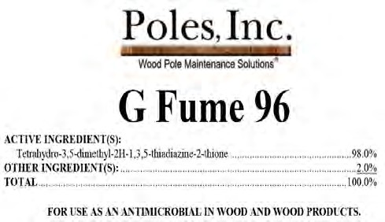
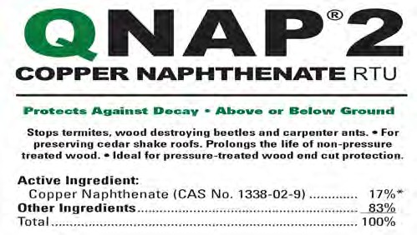
About Pesticides
SECTION II
Figure 1: Shown are examples from two wood preservative pesticide labels. Note that each of these shows only the trade name and a chemical name (for G Fume 96) or just the common name (for QNAP 2). NOTE: use of any particular label is for demonstration purposes only and not an endorsement of the product.
Common Names
Generally, active ingredients are also assigned com- mon names that are almost always easier to use then the chemical name. Common names normally appear on the label on the same line with and just before the
chemical name. If more than one company makes a product using the same a.i., the labels of ALL products with that a.i. will have the same common name regard- less of who produces it.
Wood Preservatives
W
ood preservatives are substances that, for
regulated under the Federal Insecticide, Fungicide and Rodenticide Act (FIFRA), which we discuss later. The uses of treated wood might, however, be restricted by
state law and/or the preservative la-
a reasonable length of time, protect wood
from the destructive actions of pests. Wood
preservatives are generally chemicals applied as solids, liquids, or gases, that are either toxic to wood-degrading organisms or cause some change in wood properties that makes the wood less vulnerable to degradation.
bel.
Oilborne Preservatives
Oilborne wood preservatives are for- mulated with such solvents or car- riers such as mineral spirits, petro- leum oils, and creosote (the latter is also a wood preservative). Solvents influence several properties, includ- ing wood color and paintability. So, where possible, solvents are chosen based on the desired use of the wood
Wood-Preserving Standards
The American Wood Protection Association (AWPA) annually pub‑ lishes its book of standards: de‑ tailed descriptions of the chemical and physical properties of wood preservatives. You can refer to the AWPA Standards for acceptable preservatives and treatments.
Preservatives are usually used in liquid form. They rely on solvents to carry the toxic chemicals into the wood. Each wood-preserving chemi- cal has unique properties of its own.
Wood preservatives are generally classified as oilborne preservatives or waterborne preservatives based on whether the preservatives are dissolved or suspended in either oil or water. We will also briefly discuss fumi- gant wood preservatives.
Regulations
Wood preservatives are subject to federal and state pesticide regulations just like other pesticides. How- ever, the U.S. Environmental Protection Agency (EPA) classifies wood products that have already been treated with preservatives as “treated articles” rather than as pesticides themselves. Therefore, treated wood is not
product.
Treatment with oilborne preservatives does not make wood swell. The solvents make treated wood less sus- ceptible to cracks and checking.
☞ Keep in mind that oil-based solvents are flammable and can pose health risks to you. Follow safe han- dling procedures on product labels.
Creosote
Creosote, a distillate of coal tar, is a brownish black, oily liquid with a heavy, tar-like odor.

Slide 21
Important Note Regarding Chemical Wood Preservative Information
At the time of this manual’s publication (late 2021), the EPA was in the process of “reregistration” decisions regarding the use of a number of wood preservatives including:
Pentachlorophenol,
Chromated arsenicals,
Dichromic acid, and
Cresosote.
The result of the EPA’s decisions could substantially change the requirements for using these products, or, if they can be used at all (it’s possible that the use of pentachlorophenol may be cancelled). Always remember to follow the rules on the pesticide label for up-to-date requirements.
Application and Effect on Treated Wood
Creosote is used in pressure treatments of both hard- woods and softwoods and is always heated before being pressurized into wood because it is too viscous at nor- mal temperatures to penetrate wood effectively. With a lengthy pressure period, heated creosote can penetrate even hard-to-treat wood. Creosote can also be used to treat poles using the thermal process.
peated skin exposure in the absence of recommended hygiene practices could result in skin cancer. Creosote is also toxic to animals and its vapors can harm grow- ing plants. For these reasons, creosote is a restricted- use pesticide (RUP).
Pentachlorophenol
Pentachlorophenol, or “penta,” is a crystalline, odorless solid that can be dissolved in light or heavy petroleum oil.
Treated wood is oily to the touch and does not take paint well, which could limit its uses. Compared to un- diluted creosote, solutions with oil reduce weathering and checking.
Application and Effect on Treated Wood
Penta can only be applied by pressure treatment. It penetrates most woods well. For hard-to-treat wood, heating and increased pressure times or using lighter oil solvents can increase penetration. After treat- ment, crystals might form on the wood surface (called “blooming”) as penta is exuded and the solvents evapo- rate.
Pests Controlled and Use of Treated Wood
Creosote is effective against most wood-destroying or- ganisms and has a long history of use. It resists leach- ing and is not very volatile, so it provides long-lasting protection under varied conditions. Treated wood can be used above ground as well as in contact with ground or water. In warm waters, higher retention or dual treat- ment with CCA (another preservative described later in this chapter) is needed to protect against marine borers. The primary wood products treated with creosote in- clude railroad cross ties, utility poles, and dock pilings (marine and freshwater) and timbers. Note that these are all exterior, industrial uses.
☞ Creosote-treated wood is not for residential use; nor is it for use indoors where people are or for use near plants, animals, or food.
The solvent used to dilute penta affects:
The odor and color of the solution (nearly colorless to dark brown),
The appearance, cleanliness, weight, and paintabil- ity of the treated wood, and
How the wood can be used. For example, while heavier solvents cause more problems with paint- ability, color, and cleanliness of the treated wood and make it up to 20% to 50% heavier, they allow the wood to be used in harsher environments, such as for ground contact.
Health and Environmental Concerns
According to EPA, creosote contains compounds iden- tified as possible cancer-causing agents. Its vapors are irritating to the eyes and respiratory tract—prolonged or repeated excessive inhalation exposure can cause inflammation in the respiratory tract and possibly changes in liver, thyroid, and blood elements. Contact with the preservative can cause skin irritation, burns, dermatitis, or sensitivity to sunlight. Prolonged and re-
Pests Controlled and Use of Treated Wood
Penta resists leaching because it is relatively insoluble in water. It protects against decay fungi and insects in wood used above ground, in ground contact, and in freshwater.
Penta is most commonly used to treat utility poles and crossarms.

Slide 22
☞ As with creosote, you cannot use wood treated with penta for residential use, nor is it suitable for use in living areas or where contact with plants, animals, or food is likely.
Oxine Copper
Oxine copper (copper-8-quinolinolate or “Copper 8”) is a greenish brown solution that contains copper and nickel in equal amounts. You can dissolve it in a range of organic solvents, but protection is best when you use heavy oils.
Health and Environmental Concerns
Penta is a restricted-use pesticide because of concerns that it can cause tumors, birth defects, and cancer. Preg- nant women should avoid all direct exposure to penta. Vapors irritate the eyes and respiratory tract. Contact with penta can cause skin disorders or irritation. Inha- lation of concentrated vapors or excessive skin contact with penta can cause fever, headache, weakness, diz- ziness, nausea, loss of coordination, sweating, convul- sions, and low body temperature. Prolonged exposure can damage the liver, kidneys, and nervous system. Some formulations can be fatal if inhaled or absorbed through the skin.
Application and Effect on Treated Wood
You can use oxine copper for pressure treatment of softwoods and hardwoods and for nonpressure sapstain control. Solutions are heat sensitive, but oxine copper can penetrate hard-to-treat species fairly well without added heat. Treated wood is odorless and can be paint- ed.
About Pesticides
SECTION II
Pests Controlled and Use of Treated Wood
Oxine copper is toxic to wood-destroying fungi and insects and is effective above ground but not when in ground contact. Exterior, above-ground uses include playground equipment and decking. Oxine copper is permitted for use in wood that comes in direct contact with food, such as flooring in meat lockers, food pal- lets, and crates.
Penta is also toxic to plants, fish, and wildlife. Penta is a marine pollutant and is not approved for use in wood products that would be used in marine environments.
Copper Naphthenate
Copper naphthenate is a viscous, dark-green liquid that can be dissolved in heavy or light oils, though formula- tions that are emulsifiable in water are also available. Use of lighter oils aids penetration into hard-to-treat species.
Health Concerns
Oxine copper also comes in a water-soluble formula- tion. In that form, it is corrosive and can cause irrevers- ible eye damage, so be sure to follow the label require- ment for wearing goggles.
Waterborne Preservatives
Waterborne preservatives can be dissolved or suspend- ed in water, though they might have other chemicals added (e.g., ammonia, surfactant) to aid in wood pen- etration. Most remain fixed in the wood (i.e., resistant to leaching) after treatment. Because water is the car- rier, wood comes out wet after treatment—seasoning checks and warping can occur as the wood dries after treatment.
Application
You can apply copper naphthenate by pressure (includ- ing the thermal process) and nonpressure methods. The latter includes brushing, such as for treating holes or cuts in treated wood that expose untreated wood. A common use is for brushing cut ends of treated wood for exterior use in construction.
Pests Controlled and Use of Treated Wood
Copper naphthenate protects against wood-destroying fungi and insects, though less so against termites. You can use treated wood for above-ground, ground con- tact, and freshwater uses. Treated softwoods are used for utility poles, greenhouse lumber, seedling trays, posts, piers, and docks while hardwoods are used as railroad ties. Treated wood is unsuitable for contact with food or for use in food gardens.
Almost all waterborne preservatives are applied by pressure, primarily on softwoods because hardwoods are difficult to effectively treat. Examples of treated commodities include timber, posts, building founda- tions, poles, and piling. Waterborne preservatives are especially suited for lumber because when dry, the treated wood is clean to handle, odorless, and paint- able. Some waterborne preservatives can be used in nonpressure applications, such as in dip treatments to protect millwork from sapstain; in some of these appli- cations, the preservatives are used on both softwoods and hardwoods.
Health and Environmental Concerns
Copper naphthenate can cause skin and eye irritation, and prolonged skin contact can cause allergic reactions. Wood treated with copper naphthenate has a strong odor but can be used around growing plants after the volatile solvent evaporates.
We will discuss common waterborne preservatives here. Those containing arsenic and/or chromium are

Slide 23
registered for industrial and/or agricultural use only.
orders. CCA can even be fatal if inhaled or absorbed through the skin. Chromium and arsenic can also be associated with tumor development. CCA is also toxic to fish and wildlife.
Chromated Copper Arsenate (CCA)
The three components of CCA make it a very effec- tive preservative for many situations. Copper protects against most wood-destroying insects and fungi. How- ever, it does not protect against copper-tolerant fungi. Copper can also leach out of wood that is still wet after treatment. These shortcomings are addressed by in- cluding arsenates, which kill copper-tolerant fungi, and chromates, which fix the preservative in the wood in insoluble form (making it resistant to leaching) once the wood is drip-free after treatment.
Alkaline Copper Quaternary (ACQ) Compounds Alkaline copper quaternary (ACQ) compounds come in different forms, or types.
Effect on and Use of Treated Wood
ACQ can be used on many softwood species and the range of formulations provide flexibility in treating dif- ferent species for different uses, both above ground and in ground contact.
Application and Effect on Treated Wood
CCA is applied by pressure treatment. Although wood weight can double during treatment with CCA because of the water used as the carrier, the permanent weight gain (after wood is allowed to dry) is less than 2%. This is because the retention, or amount of preservative needed to protect the wood, is so small. Treated wood is green but is clean and odorless and can be painted or glued.
Health Concerns
ACQ concentrate is corrosive and can cause skin burns and irreversible eye damage. Prolonged or frequently repeated skin contact with the amine formulation can cause allergic reactions.
Copper Azoles
Copper Azole (CA) is a fungicide and insecticide. There are two types of Copper Azole: A and B. Copper azole wood preservative is used for treating a variety of softwood species including southern pine, red pine, ponderosa pine, hem-fir and Douglas-fir. Both types of CA leave wood with a greenish-brown color and little or no odor.
Pests Controlled and Use of Treated Wood
CCA protects against wood-destroying fungi and in- sects as well as most marine borers. However, control of carpenter ants is limited because the ants chew tun- nels in wood but do not actually eat it.
CCA-treated wood is used for industrial and agricul- tural applications above ground, in ground contact, or in fresh- or salt water. Examples include utility poles, piles, highway guardrail and sign posts, agricultural fence posts, marine construction, and cooling towers.
Pests Controlled and Use of Treated Wood
Copper azoles protect softwoods from wood-destroy- ing fungi and insects. Cooper azoles have largely re- placed CCA as the preservative of choice for retail sale of lumber for residential uses.
Most applications where human contact is prevalent (in- cluding retail lumber sales) were voluntarily phased out in 2004 due to human health concerns). However, use is still allowed for lumber in permanent wood foundations:
CA treatment leaves a clean, paintable surface after drying. CA is registered for treatment of millwork, shingles and shakes, siding, plywood, structural lum- ber, fence posts, building and utility poles, land and freshwater piling, composites, and other wood prod- ucts that are used in above-ground, ground contact and fresh water as well as in salt water splash (marine) decking applications.
Structural piles used to support residential struc-
tures, and
Treatment of engineered wood products, such as glue-laminated beams, structural composite lumber, and plywood.
Health Concerns
Copper azoles are corrosive and can cause skin burns and irreversible eye damage.
Health and Environmental Concerns
CCA is a restricted-use pesticide because of health con- cerns. The concentrate is acidic, so it is corrosive and can cause irreversible eye damage. It can irritate the skin and mucous membranes. Exposure to high con- centrations can cause headaches, abdominal distress, dizziness, muscle spasms, and convulsions. Prolonged exposure can lead to persistent headaches, upper respi- ratory irritation, liver damage, anemia, and skin dis-
Inorganic Boron (Borates)
Borates leach easily from treated wood, therefore, the treated wood is only suited for above ground use and where it can be protected from getting wet. The high solubility actually aids penetration during treatment, as borates “follow the water” into the wood’s interior.

Slide 24
Application and Effect on Treated Wood
Borates can be applied by pressure treatment. One form, sodium octaborate, is especially water mobile and can penetrate hard-to-treat species with the use of heated solutions, extended pressure, and a diffusion pe- riod after treatment.
Pests Controlled and Use of Treated Wood
ACC protects wood against insects, marine borers, and fungi other than copper-tolerant fungi. It is used in cooling towers and for many of the same uses as CCA except that it provides less protection in ground contact situations.
☞ As with CCA, ACC-treated wood cannot be used for residential purposes.
Borates can also be applied by dip and diffusion treat- ment. Borates are allowed for treating cut ends of treat- ed lumber intended for interior use. Borates add no col- or to treated wood and so do not interfere with staining.
About Pesticides
SECTION II
Health Concerns
ACC is a restricted-use pesticide because chromium compounds are be associated with tumor development. It is corrosive and can cause irreversible eye damage. It can irritate the skin and mucous membranes, and prolonged or repeated skin contact can cause allergic reactions. ACC can even be fatal if inhaled or absorbed through the skin.
Pests Controlled and Use of Treated Wood
Borates provide protection against fungi and insects. Pressure treatment of various softwoods for framing lumber in areas with high termite hazard and for cabin logs is common. In the latter case, the wood must be stained to prevent the preservative from leaching out when the logs are exposed to rain.
Health and Environmental Concerns
Borates can cause mild eye irritation but have low tox- icity to fish, birds, and mammals.
Fumigants
Fumigants are poisonous gases that kill when absorbed or inhaled. Chloropicrin, methylisothiocyanate, and sodium methyldithiocarbamate are fumigants used to retreat wood that is in service (such as standing utility poles) to extend the service life of the wood.
☞ Fumigation of wood for other reasons requires cer- tification in the commercial category 7.2, Space & Commodity Fumigation so we will not discuss such treatments in this manual.
Acid Copper Chromate (ACC)
Acid copper chromate (ACC) uses chromium to fix the copper in treated wood.
Application and Effect on Treated Wood
ACC can be applied by pressure treatment to both soft- woods and hardwoods. However, like CCA, it is not heat stable, so you cannot use higher temperatures dur- ing treatment to increase penetration into hard-to-treat species like Douglas-fir and white oak. Treated wood is light greenish brown with little odor, clean, and paint- able.

Slide 25
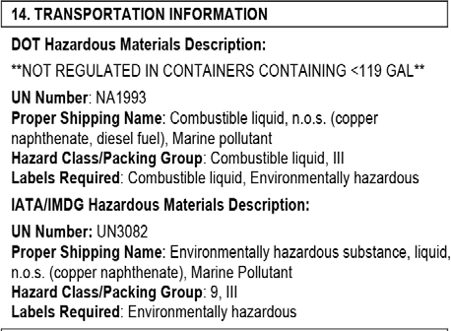
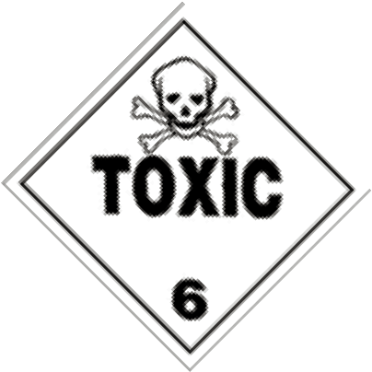
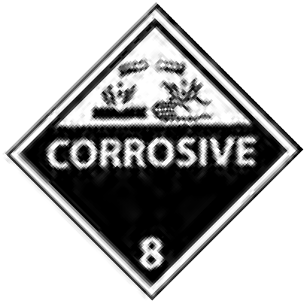
Transporting Pesticides
I
n your line of work you might not ever transport pesti-
cides in quantities sufficient to trigger the regulations
outlined below. However, you should be aware that
there are regulations to follow if you do so. The federal
Department of Transportation (DOT) has designated many chemical compounds as hazardous materials. Chemicals are listed as hazardous materials because they would pose an unreasonable risk to health, safety and property if spilled during transport.
When transporting such materials you may need to:
Receive haz- ardous material training,
C a r r y e me r- gency response information in your vehicle,
Carry shipping papers in your vehicle,
Placard your vehicle (Figure 3), or
Have a Com- mercial Driver’s License (CDL).
Figure 4: This shows a part of the Safety Data Sheet for the product “QNAP 2.” The Transport Information section indicates it is not regulated by the Department of Trans- portation IF transporting under 119 gallons. However, other products you may use might be. It’s never a bad idea to check with your company’s compliance officer (if you have one) or your local DOT to make sure (see Appendix A).
Figure 3: An example of possible placards that may need to go on the outside of your vehicle when transporting certain pesticides.
The safest way to transport pesticides is in the back of a truck—never carry pesticides in the passenger com- partment of any vehicle. Also, do not let passengers or animals ride in the back with the pesticides. Do not carry food or PPE with pesticides in the back of the vehicle.
Checking Transport Status
So, how do you know if the material you need to trans- port is regulated? There are a number of ways to check. Perhaps the quickest is to check the “Transport” and “Regulatory Information” section of the SDS sheet (Sections 14 and 15). If a hazard class is not listed and not somehow indicated to be nonregulated, such as the words “none” or “not regulated,” contact the product’s manufacturer or your distributor before transporting the material. Be sure the EPA registration number on the SDS matches that on the product’s pesticide label. Figure 4 shows an example of the transportation sec- tion of a SDS.
General Transportation Safety
Besides the legal requirements we just discussed, you should always be mindful of the safest ways to trans- port pesticides. We outline some of these below.
Make sure your vehicle is in good working condition to reduce the chance of an accident. Keep the follow- ing equipment with you in the vehicle so that you can respond quickly in case there is a spill, fire, or accidental exposure:
PPE (in the passenger compartment of the vehicle),
Soap and water,
A shovel for building dirt dikes to contain a spill,
Absorbent material (e.g., kitty litter) to soak up spilled pesticide, and
A fire extinguisher.
In addition, you should have a list of emergency phone numbers for reporting a spill. We will discuss this in more detail in the chapter, “Emergency Planning, Spills and Fires.”
30 CHAPTER 4

Slide 26
Deviations from Label Directions
W
e have already mentioned that it is illegal to
uses, which might cause unforeseen problems and lead the EPA to cancel the product altogether, FIFRA pro- hibits any use not specified on a product label. However, because some deviations will cause little, if any, harm, FIFRA was later modified to allow certain deviations.
Allowed Deviations
Unless the label prohibits you from doing so, you may deviate from label directions by:
use a registered pesticide “in a manner incon-
sistent with its labeling.” The reason for this
is quite simple: if a use is not specified on the product
label, then either the effects of that use were not evalu- ated by the manufacturer or the use was found to pose an unreasonable risk. Either way, you have no way to predict whether the use will be effective or what adverse effects it might cause. Rather than allow unauthorized
Applying a pesticide at a lower rate, concentration, or frequency than that specified on the label,
Applying a pesticide against any target pest not specified on the label if the application is to the site specified on the label,
Using any method of application not prohibited by the label, or
Mixing two or more pesticides, or mixing a pesticide with a fertilizer when such mixture is not mentioned by the label.
Restrictions that Supersede the Label
Label directions must be consistent with federal laws.
However, each state may pass pesticide laws that are more strict than (or in addition to) federal laws. It is important that you know Wisconsin’s laws that govern pesticide use. Otherwise, you might violate state law even though you followed label directions. The following examples illustrate this point:
Wisconsin requires all people applying pesticides to public K-12 school grounds to be certified.
Wisconsin has strict regulations on how close to a waterway you can be when mixing and loading pesticides. These regulations may be more strict than those found on a pesticide label.
As discussed in the previous chapter, a state can de- velop special rules that place restrictions on the use of a particular pesticide. Usually, these restrictions would not appear on the pesticide label.
Be aware, however, that you alone are liable for any problems that result from these uses. Therefore, before deviating from label directions as just described, seek evidence (e.g., university research data) that the intend- ed application will be effective in your situation. Just because you may legally deviate from the label in some ways does not mean it is always wise to do so.
Laws & Regulations
SECTION III
No deviations, other than those listed above, can legal- ly be made from label directions.

Slide 27
Special Considerations for Wood Preservative Labels
W
ood preservatives are pesticides. You’ve
“For specific retention rates (amount of preservative left in the wood), follow the use instructions in the AWPA Use Catego- ries listed here: UC 1, 2, 3B, 4A, 4B, 4C, 5A, 5B, 5C.”
“Impregnation procedures must adhere to the current specifications of the preserva- tive manufacturer or the AWPA. The percent solution to be used should be based on the retention specified by the purchaser and by the treating processes used.”
learned in this chapter that you must not use
a pesticide in a manner that is inconsistent
with its labeling, including (and especially) with regard to where you can use a pesticide and how much you can
use. You also learned that “labeling” includes the label that is attached to the product container (or its packaging) as well as any other requirements or literature provided by the manufacturer.
However, wood preservatives are unique in that their labels might not directly tell you which wood products you can treat or how much preservative to use when you treat them. Instead, many will carry statements telling you to refer to other sources for this information. Fol- lowing are some examples of such label statements.
“Wood treaters must not knowingly pres- sure treat wood commodities that are not encompassed by the use categories listed on this label as set forth in the most current edition of the AWPA Book of Standards.”
Statements such as these that instruct you to follow guidelines provided elsewhere are called “labeling by reference.” For example, in cases where the label in- structs you to follow AWPA Standards, those standards become part of the product’s labeling. Therefore, you would have to comply with the appropriate AWPA Standards when you treat wood with the product. When instructions are more vague (e.g., “provide adequate penetration and retention”), it will usually be the cus- tomer or preservative manufacturer that specifies how much product to use. Therefore, you should keep cop- ies of the specifications to follow—regardless of their source—in your files along with copies of the product label. Refer to them when you treat wood to ensure that you comply with the product’s labeling.
“Wood should be pressure treated in a com- mercial vessel capable of physically impreg- nating the wood and providing adequate penetration and retention.”

Slide 28
.
Delayed Effects
Delayed effects are illnesses or injuries that do not ap- pear soon after you are first exposed to a pesticide as we’ve just discussed. In fact, delayed effects could ap- pear weeks, months, or even years later. Whether or not you experience delayed effects depends on the particu- lar pesticide, the extent and route of exposure(s), and how often you were exposed.
Determining Delayed Effects
Because of the time lapse between exposure and ob- servable effects, and because other types of exposures may have occurred during the delay, it is often hard to identify the cause of delayed effects. Also, a person’s lifestyle choices (e.g., smoking, eating habits) as well as genetics can cause or influence the onset of some of the conditions described above. In addition, delayed effects of pesticide exposure, especially chronic and developmental/reproductive effects, are initially de- tected in laboratory animals in controlled experiments; predicting what effects will be seen in humans is more difficult.
Delayed effects can be caused by:
Health Precautions
A one-time exposure to a pesticide that does not
cause a harmful reaction until much later, or
Chronic exposure—repeated exposures to a pesti- cide (or pesticide group) over a long time (usually years).
When there is clear evidence that a pesticide may cause delayed effects in humans, the EPA determines the ap- propriate steps for reducing the risk. Options include cancelling the product, requiring label warning state- ments, changing label directions, and classifying the pesticide as restricted-use.
Of course, there are cases that do not fit neatly into these two categories.
SECTION IV
Although, as stated earlier, delayed effects are harder to study that doesn’t mean they don’t exist. There are different kinds of delayed effects including:
Chronic effects, which appear a long time, usually
Chronic Toxicity Example
In addition to acute toxicity of alcohol, chronic effects can also occur from alcohol use over long periods. Cirrhosis and other liver diseases, miscarriages, cardiovascular disease, neurological effects, and various cancers have been shown to be associated with long‑term use of alcohol. As with acute effects, the illnesses and symptoms expressed in different people depend on the dose, the frequency of exposure, body chemistry, weight, diet and exercise, and other factors.
Toxic Effects of Wood Preservatives
Tcheck the label for specific symptoms and other
able 4 lists the effects of exposure to the major
“The U.S. EPA has determined that pentachlorophenol can produce defects in the offspring of laboratory animals. Exposure to pentachlorophenol during pregnancy should be avoided.”
wood preservatives. Before using any pesticide,
health warnings. For example, labels of products contain- ing penta or its salts must state the following:

Slide 29
Table 4. Potential human health effects of exposure to wood preservatives.
Preservative | Acute Effects | Delayed Effects
Creosote | Skin and eye irritation Eye and respiratory tract (lungs and throat) irritation from vapors and fumes produced by heating Skin may become sensitive to sunlight | Cancer in laboratory animals Skin cancer in some workers Mutagenic effects in laboratory animals Dermatitis (a skin condition) following prolonged and repeated exposure
Penta | Skin, eye and respiratory tract irritation Ingestion of penta solutions, inhalation of concentrated vapors, or excessive skin contact may lead to fever, headache, weakness, dizziness, nausea, loss of coordination, profuse sweating, convulsions, and hypothermia (low body temperature) | Birth defects in laboratory animals Dioxin contaminant causes cancer in laboratory animals
Inorganic Arsenicals (CCA compounds) | Concentrated forms may cause severe burns to eyes and skin Exposure to high concentrations can cause nausea, headache, diarrhea, and, if ingested, abdominal pain Exposure to mist can cause ulceration and perforation of nasal septum Prolonged exposure can produce chronic, persistent symptoms of headache, abdominal distress, salivation, low-grade fever, and upper respiratory irritation Long-term effects can include liver damage, loss of hair and fingernails, anemia, and skin disorders | Mutagenic effects in laboratory animals Associated with cancer in humans who drank water, or breathed air contaminated with arsenic

Slide 30
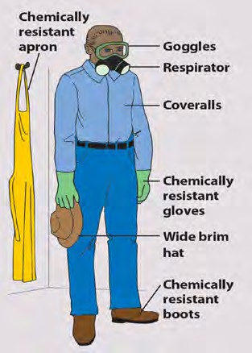
Protecting Yourself
CHAPTER 7
LEARNING OBJECTIVES
List precautions you should take in addition to wearing PPE to reduce your exposure to pesticides. Explain who is covered by the Hazard Communications Standard. Explain what features make for effective PPE. Also explain how those features might reduce worker acceptance of PPE. Recognize that no material is resistant to all chemicals, and that some are not resistant to any. Outline how to properly use PPE such as work clothes, spray suits, and eye protection. Describe the types of gloves to wear when handling pesticides and how to wear them. Discuss and describe the common types of respirators you might use. Explain the importance of fitting a respirator and how often a person should do so. Describe how to wash, and when to discard, PPE.
KNOW THE LAW
✪ Employers must make sure respirators are properly fitted to their employees.  Employers with one or more employees must comply with the Hazard Communication Standard to protect employees who handle hazardous chemicals.
General Precautions
Thazards to people. We saw that
he last chapter showed that
tions to further reduce your exposure whenever you handle pesticides:
pesticides can pose significant
while you can never eliminate the hazard associated with pesticide use, you can reduce it by lowering your exposure to pesticides. One major way to reduce your exposure is to wear the proper personal protective equipment (PPE).
Never eat, drink, or smoke while handling pesticides. Doing so would lead to oral exposure because your hands (or gloves) will likely be contaminated with pesticides.
Wash your hands after handling pesticides. Unwashed hands in- crease the risk of oral exposure as well as exposure to other parts of your body.
Take a shower at the end of each work day, paying particular atten- tion to your hair and fingernails. Put on a complete change of clothing.
Use common sense. No recom- mendations cover all situations. There may be times when you feel that you should wear more PPE than the label requires.
Wearing PPE greatly reduces your dermal, inhalation, and eye exposure to pesticides (Figure 1).
☞ The label’s precautionary and personal protective equipment statements will list the required protection. As with all label in- structions, follow them explicitly.
Figure 1: The types of PPE that you’ll need to wear depend on the pesticide involved and the handling activity (e.g., mixing/loading, apply- ing, early entry into a treated site).
Keep in mind that PPE reduces exposure, but does not eliminate it. Therefore, take the following precau-

Slide 31
Hazard Communication Standard
Tknow law, better known as the Hazard Communi-
cides) in the workplace. With the exception of farms, the HCS covers all employers with one or more employees. For more information on the HCS and/or help in develop- ing an employee training program, contact the Wisconsin State Laboratory of Hygiene (see Appendix A).
he Occupational Safety and Health Ad-
ministration’s (OSHA) employee right-to-
cation Standard (HCS), is designed to protect employees
who handle or use hazardous chemicals (including pesti-
Requirements of the Hazard Communication Standard
Chemical Inventory: Employers must compile a list of all hazardous chemicals in their workplace. OSHA’s defini‑ tion of a hazardous chemical is broad and includes thousands of products. Products are determined to be hazardous based on categories of health and physical hazards.
Safety Data Sheets: Employers must keep on file a SDS for each hazardous chemical in the workplace where em‑ ployees can review them without having to ask permission.
Warning labels: Each container of hazardous chemical must be labeled, tagged, or marked with the identity of its contents, appropriate hazard warnings for employee protection, and the name of the chemical manufacturer. Labels on pesticide containers already have such information, so further labeling is not necessary so long as the label is leg‑ ible. The warning label must contain the same chemical name as the SDS on file for that chemical.
Training: Employers must conduct an information and training program for employees exposed to hazardous chemi‑ cals. This training must include a review of the HCS, where SDSs are filed and how to interpret the information on a SDS, the health effects of the hazardous chemicals in the workplace, where PPE is kept and when it is to be used, employee work practices to minimize exposure to chemicals, and chemical spill response procedures.
Written Hazard Communication Program: The written program must include the policies and procedures used at your facility to ensure that the requirements of the HCS are met. It also must include your plans for labeling products, how SDSs will be obtained and where they will be kept, how information and training will be provided to employees, how workers will be informed of hazards, and a list of all hazardous chemicals in the workplace.
Health Precautions
SECTION IV
Selecting and Using PPE
Bsocks. PPE, as defined by the EPA, includes
cides away from your body,
Resistant to punctures or tears under normal condi- tions of use,
Well sealed at seams, and
Comfortable enough that people will accept it.
asic protective work clothing consists of a long-
sleeved shirt, long pants, closed toed shoes, and
other protective gear such as coveralls, aprons, gloves, footwear, headgear, eyewear, and respirators.
No single material is resistant to all chemicals or in all situations. The label will list specific chemical-resistant materials by name that you should use for that particu- lar product and formulation. Even when the best ma- terial has been selected, the effectiveness of the PPE also depends on its design and construction, whether it is used and maintained correctly, and how long it is used. Pesticides can move through spaces between fi- bers, through seams or closures, and/or through holes and tears. Pesticides might even move through resistant material if given enough time to do so.
General Characteristics of PPE
When selecting PPE keep in mind that:
The effectiveness of the barrier increases with the thickness of the material,
The less penetrable the material is by air, the more effective the barrier is,
Comfort decreases as the effectiveness of the barrier increases, and
Worker acceptance of PPE decreases as comfort decreases.
To be effective, PPE must be:
Chemical resistant or otherwise able to keep pesti-
In other words, the thicker the barrier, the better the

Slide 32
protection, but also the hotter and more uncomfortable it is for users wearing that PPE.
Never wear cotton, leather, or canvas gloves. They don’t protect your hands from exposure. Instead, these materials absorb pesticides, are difficult to clean, and could become a source of chronic exposure. Also, do not use baby powder or talc to help ease putting on your gloves because it can soak up any pesticide that gets inside your glove, holding it next to your skin and pro- longing your exposure.
Work clothes
At a minimum, wear a long-sleeved shirt, long trou- sers, shoes, and socks before you work with pesticides. All should be clean, dry, and free of holes and tears. Shirts and trousers should be firmly woven. Shirts should have a collar and cuffs that fit snugly when but- toned. Work clothes are not chemical resistant—they only help to keep small amounts of contaminants away from your skin.
If you’ve handled pesticides since last washing your hands, wash your hands before putting on gloves. This minimizes contaminating the inside of your gloves. For example, contamination can occur if you remove your gloves to adjust equipment, open a container, or re-tie a loose shoelace and then put your gloves back on with- out first washing your hands.
Eye and Face Protection
Wear tightly fitting, non-fogging protective eyewear whenever:
Coveralls
Coveralls should cover your entire body except your feet, head, and hands. They may be either disposable or reusable. You can wear disposable coveralls several times if they remain free of significant contamination. Fabric coveralls are not chemical resistant—they sim- ply provide an additional layer of clothing. Coveralls worn over your work clothes might not protect you if you splash or spill pesticide concentrate on yourself.
You use pressurized equipment or liquid concen- trates,
There is a chance for mists, dusts, or splashes, or
The label tells you to use such PPE.
Spray Suits
Spray suits provide an added measure of protection because they are chemical resistant and can be worn instead of coveralls. Hooded suits further protect your head and neck from drifting spray particles.
Gloves
Wear unlined, chemical-resistant gloves whenever you handle pesticides, containers, or pesticide-contaminat- ed equipment. The label might list specific glove mate- rials to use for that particular product and formulation. Some glove materials might provide hand protection for only a few minutes as in the case for disposable, single-use gloves, or for several hours for gloves de- signed for repeated use. Wear your gloves in or out of your sleeves as appropriate for the work you’re doing (Figure 2).
More Glove Information
Glove Thickness: Thickness is measured in mils (1 mil = ¹/1,000 inch). Use gloves that are at least 14 mils thick (typical “surgeon’s gloves” range from 4 to 9 mils). When selecting gloves, you will need to balance the in‑ creased protection provided by thicker gloves against the reduced dexterity and “touch” they allow.
Glove Length: Gloves are available in several lengths, called gauntlet lengths, measured from the tip of the middle finger to the edge of the cuff. Most glove lengths (10‑12 inches) provide hand and lower forearm protec‑ tion while longer lengths provide elbow or even shoul‑ der protection.

Slide 33
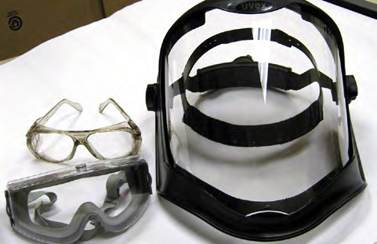
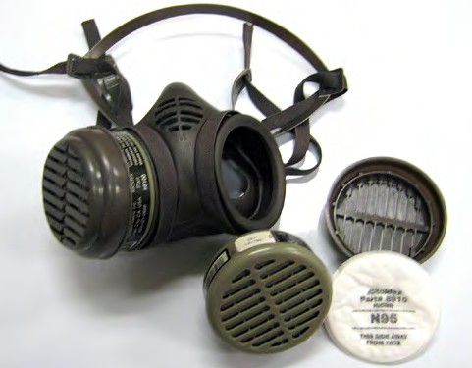
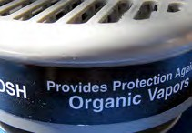
Protective eyewear includes safety glasses, face shields, and goggles (Figure 3). Headbands should be made of nonabsorbent material.
If you wear prescription glasses, goggles designed to fit over glasses will provide the best protection. Avoid wearing contact lenses when working with pesticides.
☞ Soft contact lenses can absorb chemical fumes.
Figure 3: Some different types of eye protection include simple safety glasses (top left), goggles (bottom left) and a full face shield. The level of protection you need depends on the pesticide used and the task you are performing.
Respirators
Health Precautions
SECTION IV
Eyou should be familiar with some of their basic
with an organic vapor cartridge, then you must use a vapor-removing respirator (Figure 4). Remember that air-purifying respirators only filter the available con- taminated air around you, they do not supply oxygen or protect you from fumigants.
NIOSH
When a respirator is required for working with pesti- cides, wear a NIOSH-approved device that is listed on the label (Figure 5).
ven though much of the work you do in structural
pest control may not call for the use of respirators,
characteristics and know when you should use them. Respirators protect against inhalation exposure to pes- ticide mists, dusts, or vapors. Wear a respirator when:
Required to by the pesticide label,
When you mix and load highly toxic concentrates,
When you handle or apply pesticides in an enclosed area,
When there is continuous inhalation exposure for an extended period, or
When you feel you want the extra protection.
Face Piece
Filter Cover
Filter
Pre-Filter
☞ The last point is worth stating another way: even if a respirator is not required by the label, it is some- times proper and smart to take the extra precaution of wearing one when using moderately or highly toxic pesticides or when mixing dusty formulations.
Types of Respirators
There are two basic types of respirators: air-purifying and air-supplying. We will focus our discussion on air- purifying respirators, which come in several different styles. The most common styles recommended on pes- ticide labels are dust/mist respirators and vapor-remov- ing respirators.
Figure 4: Shown here is one example of a half-face air- purifying respirator. The filter compartment on the right is separated to show the different components: Filter, Pre-Filter, and Filter Cover. Always make sure you use the proper filter for the job you are doing. If the label says to use an organic vapor filter (as shown in the inset), that is what you need to protect yourself from harmful vapors.
As with all label instructions, follow respirator direc- tions explicitly. If the label says to wear a respirator for particulates, a dust/mist respirator is fine (discussed below). However, if the label says to wear a respirator

Slide 34
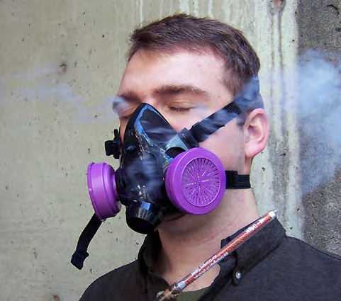
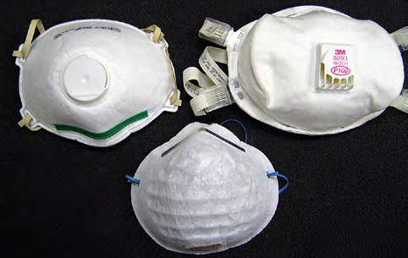
The National Institute for Occupational Safety and Health (NIOSH) certifies that respirators have been tested accord- ing to certain standards.
Dust/Mist Respirator Dust/mist respirators (Figure 6) remove dusts,
Figure 5: There are respira- tors on the market that are not NIOSH-approved, such as nuisance dust masks and some surgical masks. To make sure your respirator is NIOSH-approved go to the NIOSH Trusted-Source page at: NIOSH Trusted-Source website.
particles, and spray
mists from contaminated air as it passes through
the fabric of the mask. The higher the efficiency rating of the respirator (e.g., going from 95% to
Figure 7: During a fit test, a user might be challenged with an irritating smoke or a smell, such as a banana odor. If they can smell it, their respirator does not fit correctly. (Photo © Pacific Northwest Agricultural Safety and Health Center).
a respirator is both comfortable and correctly fits and protects the user. You must be fit-tested before you use your respirator for the first time and also be re-tested at least every 12 months to be sure that your respirator continues to fit your face. Fit testing is required by the fumigant label for each respirator. Follow-up fit testing is also required under the following circumstances:
Figure 6: Do not confuse a dust/mist respirator (two styles on top) with a simple dust mask (bottom). A dust mask does not give adequate protection for any type of pesticide application.
The style of the face piece has changed,
The respirator size, model, or brand has changed,
There is a physical change in the person’s face (e.g., weight change or dental work) that would affect fit,
Fit is unacceptable,
At request of the user, or
Employer policy.
100%), the tighter the mesh of the fabric so it can trap more air-borne particles. As the filtering material be- gins to clog up with the trapped particulates, breathing will eventually become more difficult. Such respirators do not protect you against gases or vapors.
Employer’s Responsibility
Employers must provide a respirator to employees when the pesticide label requires their use. Employers must also make sure the respirator is properly fitted and maintained. This responsibility falls under OSHA re- quirements.
Fitting a Respirator
After being cleared by a qualified medical practitioner to wear a respirator you must be fit-tested with the specific respirator you will use (Figure 7). A fit test verifies that
Fit Check
You must perform a quick fit check every time you use an air-purifying respirator (a fit check is different than a fit test). Do the fit check even for a respirator that has already been tested for fit— (Figure 8).
☞ No matter which type of respirator you use, always make sure to follow the manufacturer’s instructions to make sure the respirator fits well. There will be instructions (in more detail then we give here) for performing fit tests and checks.

Slide 35
Figure 8: Positive-pressure user seal check: Cover the exhalation port with the palm of your hand and lightly exhale into the mask. You will feel air escaping through any gaps in your seal. Re-adjust the mask until there are no leaks.
Negative-pressure user seal check: Cover or seal off the surface or hose where air is inhaled and suck in. If your mask is properly sealed, it should collapse on your face with no signs of leakage in the facepiece or hoses. If you cannot get a seal, re-adjust the mask until there are no leaks.
Health Precautions
SECTION IV
How to Get a Respirator Medical Evaluation
Ideally, medical evaluations are best conducted by occupational physicians. You will need to bring along a copy of the OSHA respiratory medical questionnaire used for screening, which can be found through the agency’s respiratory pro‑ tection website at: osha.gov/SLTC/respiratoryprotection
If you’re having difficulty finding someone to perform the evaluation, contact OSHA at: 800‑321‑OSHA (6742), or use the map at the following website to find your state’s OSHA office: osha.gov/contactus/bystate
Care of PPE
Y
ou can contaminate your PPE during normal
clothing (e.g., from cuffs and pockets).
Prerinse clothing by presoaking it in a suitable container or using the prewash cycle of an automatic washer.
Wash clothing separately from family clothing. Pesticide residues are transferred from contaminated clothing to other clothing laundered with it. Wash only a few contaminated garments at a time.
Wash clothes in hot water to more thoroughly re- move pesticides; use the highest water setting and use a heavy-duty liquid detergent. Neither bleach nor ammonia helps remove pesticides. (NEVER mix bleach and ammonia together because poisonous gases are produced.)
Drain the wash water; do not use the water-saving feature.
Check wet clothes for visible staining, unusual odor, or color differences. Wash the clothes again if any of these are present. If the second washing does not remove the stain or odor, discard the clothing.
handling and application of pesticides. Unless
you remove the contaminants, you may absorb
them through your skin.
Have clean PPE on hand at all times. To keep your PPE working well, clean it thoroughly. Below are some gen- eral cleaning guidelines.
Fabric Clothing
If fabric clothing is saturated with a pesticide concen- trate, you must discard it. Research has shown that clothing contaminated with concentrate contained a high amount of pesticide residue even after 10 washes. Remove such clothing immediately and dispose of it. Wear chemical-resistant gloves when handling severely contaminated clothing.
Following these guidelines when washing clothes you
wore while handling pesticides:
Outdoors, shake pesticide dust or granules from your

Slide 36
Line dry the clothing to avoid any possible contami- nation in the dryer. Also, sunlight may degrade some pesticide residue that laundering did not remove.
A respirator worn only by you must be cleaned and dis- infected as necessary to maintain it in a sanitary con- dition. If a respirator is shared, the OSHA respiratory protection program requires that it be cleaned and dis- infected before being worn by the next person.
Other PPE
Wash the outside of gloves and footwear with detergent and water before removing them to avoid getting pes- ticide on your hands. After you remove the gloves and footwear, wash them inside and out with detergent and water and rinse thoroughly. Test gloves for leaks by fill- ing them with water and squeezing—leaky gloves will not protect you from pesticides.
How easily laundering removes a pesticide does not de- pend on the pesticide’s toxicity—rather, it depends on the formulation.
Respirators
The OSHA respiratory protection policy requires that you properly clean and store your respirator after each use. Follow the manufacturer’s specifications for clean- ing, maintaining, and storing your respirator. Beyond those instructions, look for tears in straps, damage to the facepiece, and for worn or missing parts (e.g., valves). Disassemble reusable respirators, wash in warm detergent water, and store properly.
Finally, remember that, in time, pesticides may even permeate resistant material. So, you should replace PPE on a regular basis.

Slide 37
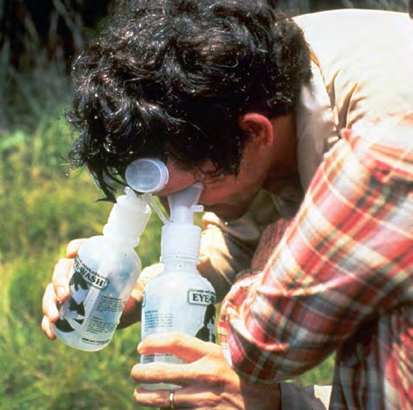
First Aid for Pesticide Poisoning
Rbecome thoroughly familiar with basic first aid
ead the first aid statements on the product label
If breathing has stopped or is irregular, give artificial respiration.
Keep the person warm and quiet. Wrap the person in a blanket—but don’t let them overheat.
If the victim is convulsing, watch for breathing irregularities and protect the victim’s head from striking the floor or wall. Keep the victim’s chin up so that the air passage will remain free for breathing.
Do not give alcohol in any form to the victim.
Eye Exposure
Hold eyelids open and wash eyes with drips of clean water (e.g., from a decontamination site).
Do not use medications in the wash water: use pure water.
Drip water across—not directly into—the eye, or use an eyewash dispenser (Figure 3).
Continuously rinse for 15 minutes. If only one eye is affected, be careful not to contaminate the other eye.
Flush under the eyelid with water to remove debris.
Cover the eye with a clean piece of cloth and seek medical attention immediately.
before handling any pesticide. Beyond that,
procedures. Learn this information ahead of time— you probably won’t have the time or the opportunity to look it up in an emergency.
As we discuss first aid, keep in mind that the procedures are only part of the remedy. We have already discussed the other component—seeking medical attention.
General First Aid Instructions
Decontaminate the victim immediately but be care- ful not to contaminate yourself in the process.
Your first response to oral or dermal exposure is usu- ally to dilute the pesticide as quickly and effectively as possible. Always have a supply of water readily available when you work with pesticides. You can use any source of fairly clean water.
If inhalation exposure has occurred, carry the victim to fresh air immediately.
Give mouth-to-mouth artificial respiration to an exposure victim whose breathing has stopped or is labored.
Never give anything by mouth to an unconscious person.
Dermal Exposure
Remove contaminated clothing.
Drench skin with water.
Wash skin, hair, and fingernails thoroughly with soap and water. Rinse thoroughly and wash again.
Gently dry the affected area and wrap it in loose cloth.
If the skin has chemical burns, cover the area loosely with a clean, soft cloth. Do not use ointments, greases, powders or other treatments unless directed by a medical authority.
Inhalation Exposure
Get a poisoning victim to fresh air immediately. If possible, carry (don’t walk) the victim.
Do not attempt to rescue someone in an enclosed area if you don’t have the proper respiratory equip- ment.
Have the victim lie down and loosen all tight cloth- ing.
Figure 3: Eyewash dispensers are helpful in washing pesticides out of your eyes if you are exposed. Carry them in your vehicle. (Photo courtesy of USDA Forest Service - Region 8 - Southern , Bugwood.org)

Slide 38
Mixing and Loading
CHAPTER 10
LEARNING OBJECTIVES
Explain why mixing and loading pesticides poses a significant hazard to the environment and the people who perform these tasks. Specify where you may never mix, load or clean application equipment with respect to wells or surface water. Explain when you would need to perform the above tasks over a spill containment surface (also called a mixing and loading pad). Describe steps you can take to minimize your exposure to pesticides when mixing and loading. Describe precautions you must take to protect the water supply when mixing and loading. Explain the restrictions on using rinsates in future mixes. Describe how to properly rinse pesticide containers and list the benefits of doing so.
KNOW THE LAW
✪ Do not fill or clean pesticide equipment where pesticide might enter a well or surface water or where rising waters could flood the filling/cleaning site.  Comply with spill containment surface requirements if you mix, load, or transfer more than 1,500 pounds of active ingredient at one site in a calendar year or if you do so within 100 feet of a well or surface water.  You may never mix or load pesticides within 8 feet of a well or surface water.  Protect your water supply from contamination by using an air gap or an antisiphoning device.  You can use rinsates in a future mix provided the pesticide in the rinsate is labeled for the site and the final mix does not exceed label rates.  Only pesticide containers that have been triple rinsed or the equivalent may be recycled or dis- posed of in a landfill.
Handling Pesticides
SECTION V
Mixing and Loading Sites
MBecause of the concentrations and quantities
Transferring pesticide to application equipment,
Handling an open pesticide container,
Rinsing a pesticide container,
Cleaning application equipment, and
Disposing of a pesticide or rinsate.
ixing and loading pesticides are often the
most hazardous activities of pesticide use.
of pesticides involved, accidental releases of pesticides at a mixing and loading site pose a high risk of ground- and surface water contamination. This is especially true when the site is also used for storing pesticides and clean- ing application equipment. Also, when you mix and load, you handle a pesticide in its most concentrated form and experience the greatest potential for exposure to yourself.
To reduce the risk of ground- and surface water con- tamination, Wisconsin places certain restrictions on mixing and loading (Figure 1).
☞ You may never mix or load pesticides within 8 feet of a well or surface water under any circumstances.
By law, “mixing and loading” a pesticide covers more than the obvious mixing and loading into application equipment. It also includes:

Slide 39
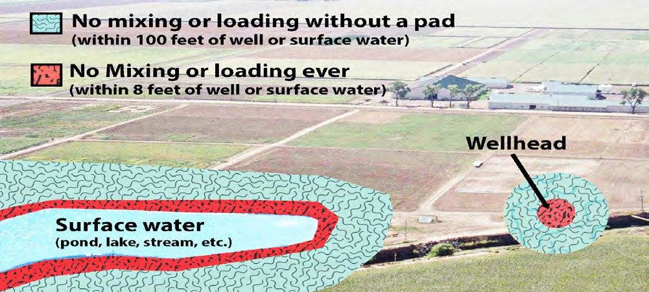
Figure 1: This figure illustrates the setbacks required from wellheads or surface waters when mixing and loading pes- ticides. Although this may not illustrate a typical wood preservation pest control scenario, the principle still applies. For example, you could be treating the outside of someone’s home who has a well or has a stream running near their house. In that case, you must abide by these restrictions. (Background photo courtesy of H.R. Duke, Bugwood.org).
☞ You cannot fill pesticide application equipment adjacent to surface waters or wells where, because of the slope or other conditions, pesticides could contaminate the surface water or well, or where ris- ing waters could reach the filling area and become contaminated. This restriction also applies when you clean pesticide equipment.
Spill Containment
If you do not meet the following exemptions, Wiscon- sin law requires you to use an impervious spill contain- ment surface (also called a mixing and loading pad) when mixing and loading pesticides (Figure 2).
If you do not meet these exemptions, then you must comply with the rules for using a spill containment sur- face. See the gray box below and ATCP 29.45 for more information. Remember, under no circumstances can you mix or load within 8 feet of a well or surface water.
Spill Containment Requirements
You must mix or load pesticides over an impervious spill containment surface if either of the following ap‑ plies:
You mix, load, or transfer more than 1,500 pounds of pesticide active ingredients at any one site in a calen‑ dar year. Two or more sites within ½ of a mile of each other and under common ownership or control are considered as a single mixing and loading site.
You mix or load pesticides within 100 feet of a well or surface water. You may not mix or load pesticides within 8 feet of a well or surface water under any circumstances.
The spill containment surface, also called the mixing and loading pad, must be curbed or sloped to contain spills and prevent water or other liquids from flowing onto it. It must also be paved or lined with liquid‑tight materials approved by DATCP. Find detailed information about spill containment requirements here: https://datcp. wi.gov/Pages/Programs_Services/AgriculturalChemi‑ calStorageAndContainment.aspx
Spill Containment Exemptions
You are exempt from the requirement for using spill containment if you mix and load pesticides under either of the following conditions:
Only into application equipment having a total ca- pacity of 5 gallons or less of liquid pesticide, or 50 pounds or less of nonliquid pesticide, or
In or immediately adjacent to the pesticide applica- tion site, as long as you are 100 feet or more from a well or surface water.
Although a mixing and loading pad is not required if you meet the above exemptions, it’s a smart idea to use an oversize tub to hold small equipment or pesticide containers to prevent spills when mixing.

Slide 40
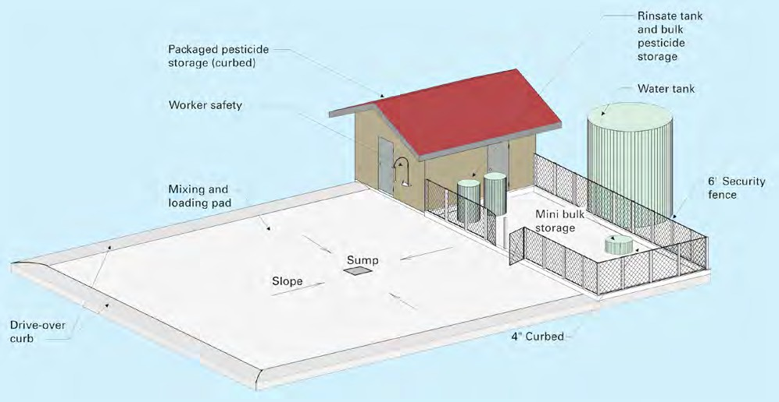
Figure 2: This figure illustrates a generic setting for a mixing and loading pad. Every wood treatment facility would have its own system for collecting possible spills and wastes. However, though the design will be different for every facility, the construction still has to satisfy the requirements of Wisconsin law. We also discuss collection via drip pads in the next chapter, “Managing Pesticide Wastes.” (Image courtesy of David W. Kammel, Biological Systems Engineering Department, UW-Madison).
Considerations for Wood Preservatives
There are large differences in the type of work a person
certified in wood preservation may be involved in.
using greater quantities to treat a person’s wood home or large deck. Then there are applicators working in wood treatment plants where very large amounts of wood preservatives are used. The purpose of pointing this out is to show that spill containment requirements can vary widely depending on the type of work you are performing.
Handling Pesticides
SECTION V
For example, you may be using small amounts of pre- servative to treat standing utility poles, or you may be
Mixing and Loading Pesticides
W
hen mixing and loading pesticides be sure to
thoroughly with soap and water. Dispose of clothing
saturated with pesticide concentrate as pesticide waste.
wear the PPE listed on the product label. If
there are no specific instructions, at least wear
Water Source
It is illegal to fill pesticide equipment directly from waters of the state other than from public water sup- plies or private wells that are fully protected against back-siphonage either by an air gap or other equivalent protection device (Figure 3).
gloves and protective eyewear in addition to your work clothes. Wear PPE, especially chemical-resistant gloves, even when you mix and load pesticides that are spe-
cially packaged to reduce exposure (e.g., water-soluble packets, closed-handling systems). It is still possible to be exposed to pesticide using these products in the case of an accident.
Additional Safety Precautions
Read the first aid instructions on the label before you open the container. Have a supply of clean water and soap at hand. If you splash or spill a concentrate on your work clothes, stop what you are doing immediate- ly. Remove contaminated clothing and wash yourself
Adding Water
Be extremely careful to avoid overflow when you add water to your equipment. Never leave equipment unat- tended while it is being filled.
Rinsates
Rinsate is pesticide-contaminated liquids that you can

Slide 41
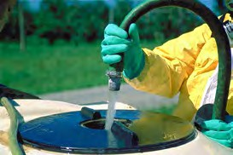
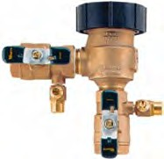
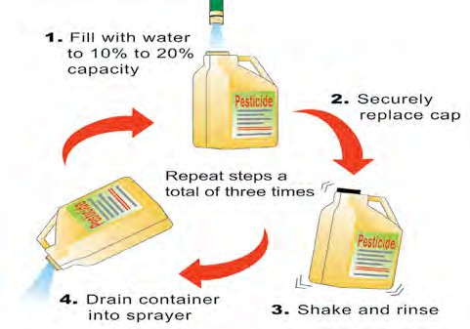
reuse by applying it to a labeled site. A typical source of rinsate is water used to wash application equipment.
You can use rinsate as make-up water for future applica- tions provided:
The pesticide(s) in the rinsate is labeled for the intended application site, and
The amount of pesticide in the final mix does not exceed label rates for that site.
Figure 3: To maintain an air gap (left), keep the hose or pipe above the level of the mixture at all times during mixing and loading. The gap must be at least twice as wide as the opening of the water supply line, but not less than 1 inch wide. It is safe to have an input line sub- merged in the mixture only when it is equipped with a reliable antisiphoning device (right) that meets Dept. of Commerce plumbing standards.
☞ If you do not meet these two requirements, you can- not legally apply the final mix to the intended site.
Adding Pesticide
Open pesticide containers carefully. Never tear open pesticide bags, instead, use a sharp knife. Clean the knife afterwards and do not use it for other purposes.
When you pour a pesticide, keep the container well below eye level to minimize the risks of eye and face exposure. Use a pump to remove a concentrate from a large container.
Close unemptied containers immediately and return them to storage. If you are mixing and loading at the site of application, you must temporarily store the pes- ticides and their containers in a secure area until you can return them to your storage facility.
Emptying Containers
Once you use the entire contents of a pesticide container, you need to make sure it is completely empty. This involves properly rinsing plastic or metal containers or cutting open paper containers to thoroughly remove all contents. By fully emptying containers this way, you:
Figure 4: Although a trace of residue will remain in a container even with the best rinsing procedures, triple rinsing is extremely effective. Remember to rinse the cap as well.
Triple Rinse
Always triple rinse containers as soon as you empty them (Figure 4). If you put it off until later, you may find it hard to remove pesticide residue that has dried in the container; also, you may no longer have a use for the rinsates.
Save money by using all the pesticide in the con- tainer,
Protect the environment from a potential source of contamination,
Meet federal and state regulations on pesticide use and disposal, and
Make the container a solid waste even if it had contained a hazardous pesticide.
Do not leave even triple-rinsed containers at the appli- cation site. Someone who doesn’t know better may use the containers for another purpose. Remember, proper disposal of pesticides and their containers is your re- sponsibility.

Slide 42
Managing Pesticide Wastes
CHAPTER 11
LEARNING OBJECTIVES
Define when pesticide becomes waste and who is responsible for disposing of it. Compare and contrast solid vs. hazardous waste. Specify which type of pesticide waste you may dispose of in a sanitary landfill. Describe your options for disposing of pesticide containers and other solid wastes. Explain how to deal with leftover liquid pesticides, unwanted, banned or unidentified pesticides, and other pesticide solid waste. Outline the criteria for a chemical to be classified as “hazardous.” List your options for disposing of hazardous waste. Explain your liability for disposing of hazardous waste. Describe how the “Wood Preservative Hazardous Waste Listings Rule” affects how you handle wood preservative waste.
KNOW THE LAW
✪ You are responsible for the proper disposal of pesticide wastes that you generate.  You cannot reuse a pesticide container for any purpose other than recycling or returning it to the dealer or manufacturer.  You cannot dispose of hazardous pesticide waste in a sanitary landfill.  You cannot bury or burn pesticide containers.  You can only dispose of hazardous wastes in a licensed hazardous waste management facility, at a Wisconsin Clean Sweep program, or at approved collection facilities.
Waste Defined and Waste Reduction Guidelines
Y
our final act in using a pesticide is to properly
In this chapter, we provide guidelines for reducing the amount of waste you generate and outline your options for disposing of pesticide wastes.
dispose of any resulting pesticide wastes.
☞ State and federal regulations make you responsible for the proper disposal of pesticide wastes that you generate.
With respect to pesticides, we define waste as material that:
Has served its originally intended purpose, or
You intend to discard.
The federal government regulates the disposal of pes- ticide waste under FIFRA and the Resource Conser- vation and Recovery Act (RCRA). In Wisconsin, the DNR further regulates waste disposal under Adminis- trative Codes NR 500 and NR 600 series.
As an example, suppose you have been using a liquid pesticide and have accumulated several empty contain- ers. These containers have served their intended pur- pose and have therefore become waste. By law, you cannot use empty containers except for recycling or return to the manufacturer.
Improper handling or disposal of pesticide waste leads to contamination of soil and ground and surface wa- ter, causing serious human health issues, harm to fish and wildlife, liability problems for the pesticide user, as well as a poor public image.

Slide 43
Table 1 lists more examples of pesticide wastes. While you may rarely, if ever, generate some of these wastes, you may frequently end up with empty pesticide con- tainers.
is to not generate waste in the first place. This in turn will also reduce any associated risks to humans and the environment. The guidelines provided in Table 1 will help you toward this end—most require little or no in- vestment.
There are few low-cost options for disposing of pesti- cide wastes. The best way to reduce your disposal costs
Table 1: Types of Pesticide Waste and How to Reduce Waste
Type of Pesticide Waste | Waste Reduction Guidelines
Canceled Pesticide | Purchase only as much pesticide as you need for a single treatment season. Date products and use older products first.
Damaged Pesticide or Pesticide Leaking from Damaged Containers | Store volatile pesticides away from other products. Do not store liquid formulations on shelves above dry formulations. Protect containers from temperature extremes and moisture. Place leaking containers inside another container.
Unidentifiable Pesticide | Store pesticides in their original containers. Make sure label stays on container and remains legible.
Unwanted Pesticide Concentrate | Determine how much pesticide you need before making a purchase.
Pesticide Residue in Container | Triple rinse containers and pour the rinsates into the pesticide mix.
Leftover Pesticide Mix | Calculate how much mix is needed for the job and calibrate your application equipment. Temporarily store unused mix in a labeled tank until you can finish the job or apply the mix to a labeled site.
Equipment Rinsates | Use clean water to rinse the inside of spray equipment at the treatment site, and then apply the rinsate to the site. Use the same equipment for similar pesticide mixes so you can use leftover mixes on subsequent jobs and minimize tank rinsates. Clean equipment on a concrete pad with a collection basin and tanks to hold rinse water. Use the rinse water for preparing future mixes for a labeled site. Segregate rinse water to avoid applying any pesticide to unlabeled sites.
Clothing Saturated with Pesticide | Wear a chemical-resistant apron or spray suit over your normal work clothes when mixing and loading.
Handling Pesticides
SECTION V
Types of Waste
A
s you might imagine the disposal of pesticide
Solid Waste vs. Hazardous Waste
Unfortunately, the legal definitions and terminology regarding waste can be quite complex (Figure 1). The term solid waste is what most of us think of as “trash” or “garbage” we produce at home, work and play. How- ever, solid waste can also be a liquid or contained gas. In terms of pesticide disposal, solid waste is anything that is not classified as a hazardous waste.
wastes is highly regulated. The first thing you
need to know is what type of waste you have so
you know how to dispose of it properly. Broadly, there
are two types of wastes you might have to deal with in your work:
Solid waste, and
Hazardous waste.

Slide 44
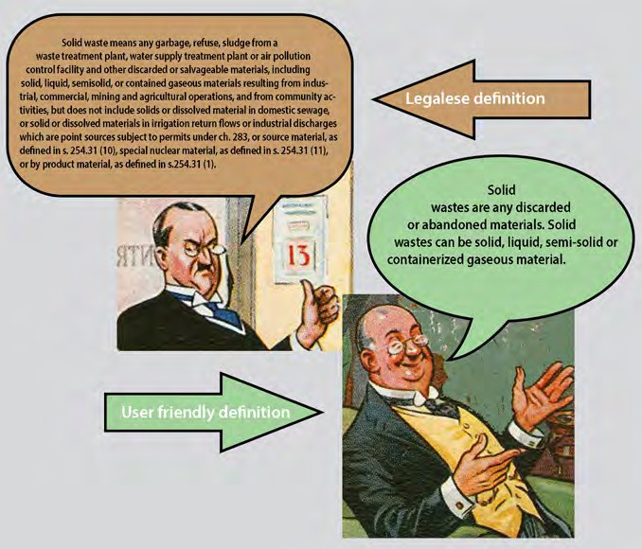
So, what is a “hazardous waste”? When we discussed transporting pesticides you learned that some pesticide products are classified as hazardous materials and more stringent rules apply when you move such products. The same is true for pesticide waste. The SDS sheet of your product, just as it did for transportation, is a good source of information that should tell you if your material is considered a “hazardous waste” (Figure 2).
☞ Although the rules for dispos- ing of hazardous waste are more stringent, keep in mind that there are dangers associ- ated with any pesticide waste, whether or not it is classified as hazardous. Always be cautious when disposing of pesticide waste—to protect yourself and the environment.
Now that we’ve defined the two broad types of waste you might have to dispose of, we will discuss each separately.
Figure 1: On the left above is one legal definition of solid waste. Don’t worry, we’re not going to make you memorize that! Fortunately we can think of solid waste more simply as “any discarded or abandoned materials.” However, that still leaves us with a bit of confusion, because solid wastes, besides being solid (e.g., an empty container), can also be a liquid, semi-solid or containerized gaseous material. Although a lawyer might not agree, you can think of solid waste in terms of what it’s not: a solid waste is anything that is not considered a hazardous waste. (Cartoons courtesy of The New York Public Library Digital Collections site: http://digitalcollections.nypl.org/)
Figure 2: This example is from a wood preservative product that contains pentachlorophenol showing that this product is considered a hazardous chemical and will have to be disposed of as hazardous waste. If you can’t find the information on the SDS, consult your suppliers/distributors or the manufacturer of the product.
Solid Waste Disposal (Not Classified as Hazardous)
Snon-hazardous pesticide wastes.
☞ Do not assume that you can take any pesticide waste to a landfill. First consult with the landfill operator to determine what types of pesticide waste, if any, the operator will accept (Figure 3).
olid waste landfills (also known as sanitary land-
fills) are licensed by the DNR and can accept any

Slide 45
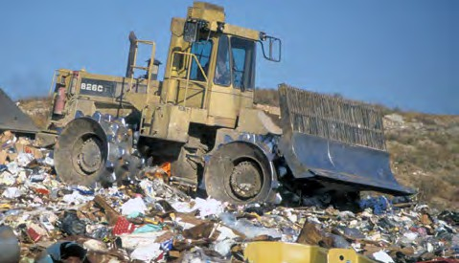
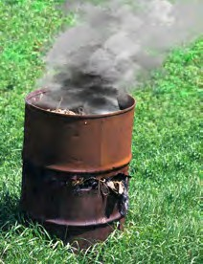
Wisconsin Clean Sweep Program
Businesses can dispose of unwanted pesticides and other chemicals through the Wisconsin Clean Sweep program. These collections are sponsored by counties, but funded through DATCP (Figure 5).
Figure 5 : Call the Clean Sweep program (through DATCP, Ap- pendix A) to find out if a Clean Sweep has been planned for your county.
Figure 3: Landfill operators can, but are not required by law, to accept solid pesticide wastes. If wastes in a landfill are found to be causing environmental or human health problems, the landfill operator shares legal liability with landfill customers. This means some landfill operators are reluctant to accept many kinds of pesticide waste. (Photo courtesy of the Wisconsin DNR).
While intended for chemi- cals, certain kinds of con- tainers can also be brought to these collection sites. The program routinely accepts metal, residue laden, and
non-recyclable plastic containers.
Applicators and dealers are treated as businesses for purposes of the Clean Sweep program and are normal- ly required to pay some fees for disposal.
Liquid Disposal
Partially-filled containers that still contain liquid must be managed as hazardous wastes (discussed later) to assure the highest level of environmental and human health protection. In general, sanitary landfills will not accept liquid wastes of any sort.
Container Disposal
Probably the largest source of pesticide waste you will generate is empty pesticide containers. Your first step in disposing of any container is to make sure it is emp- ty. We discussed how to empty and triple rinse contain- ers in the chapter “Mixing and Loading.” Containers that have not been properly triple rinsed might be con- sidered hazardous waste if the product in them is listed as hazardous.
☞ Only containers that have been triple rinsed or the equivalent may be recycled or disposed of in a sanitary landfill.
Handling Pesticides
SECTION V
Solidification
Small amounts of certain liquids (that are not classified as hazardous) can be solidified before being taken to sanitary landfills. Contact your local landfill manager to confirm this option before doing this.
☞ Do not solidify or amend liquid hazardous wastes without authorization from a hazardous waste spe- cialist—in any case, you cannot bring hazardous wastes to a sanitary landfill.
Container Disposal Options
Your only options for get- ting rid of empty pesticide containers are to (in order of most to least preferred):
Return them to the dealer for reuse or refilling,
Recycle them,
Bring them to a Wiscon- sin Clean Sweep pro- gram, or
Dispose of them in an approved landfill.
Ways to Solidify Liquid Wastes
You can use materials such as vermiculite, adsorptive clay, commercial absorbents, or cat litter to solidify liq‑ uid wastes. For the best results, liquid chemicals can be poured into lined or secured larger containers before adding or mixing absorbent materials. Occasional stir‑ ring and letting the container remain exposed to air will often result in faster solidification.
Figure 4: It is illegal in Wisconsin (and most states) to burn pesticide containers. Smoke from burn barrels contains many toxic and carcino- genic compounds. (Pho- to adapted from and courtesy of the Wisconsin DNR).
☞ It is illegal to bury or burn any pesticide con- tainers in Wisconsin (Figure 4).
Other Disposal Options
Other disposal options include contacting a commer- cial hazardous waste hauler for a pickup at your busi-

Slide 46
ness location. This option may cost more money, but it will allow for immediate disposal.
Dry Formulations
A landfill operator is not likely to accept leftover dry formulations, especially when large volumes are in- volved. Your best option is to apply the material ac- cording to label directions or go through the Clean Sweep Program.
Disposal of Unwanted, Banned, and Unidentifiable Products
Dealers may take back unopened pesticide products
that you do not want. You may not, however, be able to return banned products—dispose of them properly. Dispose of an unidentifiable product as if it were a haz- ardous waste. Your best options for disposal of these
materials is the Clean Sweep program or a private haz- ardous waste hauler. Never mix chemicals together for disposal, even if you think you know what they are.
Disposal of Spills
Usually you need to treat spilled pesticide and contami- nated soil or absorbent material as waste.
Disposal of Other Wastes
As we discussed in the chapter, “Protecting Yourself,” you cannot adequately clean clothes that have been saturated with a pesticide concentrate. Such clothes are a solid waste (if the pesticide is not listed as hazard- ous)—dispose of them in a sanitary landfill. To avoid this problem, wear a chemical-resistant apron or spray suit when you handle pesticides.
Hazardous Waste Disposal
A
s we’ve already noted, certain chemicals consid-
☞ Some pesticide products could be regulated as haz- ardous wastes under RCRA because their formula- tions (and not necessarily their active ingredients) make them flammable, or corrosive for example.
Hazardous Waste Reduction
To reduce or avoid the generation of hazardous pesticide
waste:
Use pesticides that are not listed as hazardous. Check the pesticide’s SDS sheet.
ered to be “hazardous” have special handling,
transport, and disposal requirements. We will
discuss these requirements here in general, and then follow with some specific rules and information that pertains to wood preservatives.
Hazardous waste is regulated by the EPA under the Resource Conservation and Recovery Act, or RCRA. The EPA issues a list of materials that are considered hazardous waste. Many pesticide active ingredients are on this list.
Hazardous Waste Categorization
Broadly, the EPA uses two criteria to categorize a sub- stance as hazardous:
Either it has been found to pose a hazard to humans or the environment, or
The waste exhibits certain hazardous properties (listed below).
Triple rinse all pesti- cide containers. A triple- rinsed container is not considered hazardous waste even if it originally contained a hazardous active ingredient.
Follow waste reduction guidelines in Table 1 at the beginning of this chapter.
We are simplifying things here a bit, because the actual legal definitions are complex.
Hazardous Waste Storage
Until you are ready for dis-
posal, store hazardous waste in a designated hazardous waste accumulation area. Mark all containers with hazardous waste labels (Fig- ure 6).
Figure 6: Inspect con- tainers weekly for leaks or corrosion. Replace any that begin to leak. Keep containers closed and sealed except when they are being filled or emptied. (Photo courtesy of the Pesticide Safety Educa- tion Program Improvement & Modernization Initiative).
Properties that Make a Compound Hazardous Under the RCRA, a hazardous waste is one that exhibits at least one of these four characteristics:
Ignitability,
Corrosivity,
Reactivity, or
Toxicity.

Slide 47
Liability
You are responsible for the safe cradle-to-grave man- agement of the hazardous waste you generate. This in- cludes verifying that hazardous wastes are packaged, stored, transported, and disposed of in compliance with RCRA and DOT regulations. Even when you dispose of hazardous wastes properly, you are still accountable for any damage these wastes cause to the environment or personal property. Retain for an indefinite time all
documentation (e.g., Certificate of Destruction) related to the disposal of a hazardous waste.
☞ If using a private hauler to dispose of any hazard- ous waste, it must be hauled to a licensed hazardous waste management facility by a licensed hazardous waste hauler. An alternative option is for you to bring the waste to a Wisconsin Clean Sweep site.
Wood Preservative Hazardous Waste Listings Rule
I
n the 1980s, health and environmental concerns arose
aged wood treatment facility instead of having to be disposed of as hazardous waste.
Drip Pad
After removing pressure- or nonpressure-treated wood from the treatment vessel, you must hold it on a drip pad until drippage has stopped. A drip pad is a struc- ture designed to drain preservative drippings from treated wood, precipitation, and surface water run-on into a collection system. Operators must maintain and inspect pads according to specific standards listed in the ruling, and follow required procedures for respond- ing to and reporting any leaks in the pad.
due to contaminated soil, groundwater, and surface
water at wood treatment facilities. As a result, the
EPA established the Wood Preservative Hazardous Waste Listings Rule for certain wastes from wood-pre-
serving processes that use penta, creosote, or inorganic preservatives containing arsenic or chromium.
This rule applies to pressure and nonpressure processes with the exception of wood surface protection for sap- stain control. Also, only wastes generated at treatment plants are considered hazardous.
Regulated Wastes
The following by-products of preserving wood with penta, creosote, or inorganic preservatives containing arsenic or chromium are considered to be hazardous wastes subject to the EPA ruling only if they cannot be reclaimed for reuse:
Handling Pesticides
SECTION V
Storage Yard Drippage
Infrequent and incidental storage yard drippage after wood has been removed from a drip pad is still haz- ardous waste, but the yard is not subject to drip pad regulations provided that the releases are immediately cleaned up in compliance with a written contingency plan developed by the owner/operator. The plan must stipulate how responses are to be conducted and docu- mented, what methods will be used to ensure records are retained for 3 years, and how contaminated media and residues will be managed in accordance with ap- plicable federal regulations.
Clean Closure
The Hazardous Waste Listings Rule lists requirements for “clean closure” of wood treatment plants that have stopped using penta, creosote, or inorganic preserva- tives containing arsenic or chromium. Wood treatment plants that achieve clean closure are not subject to the rule as long as they use preservatives other than those specified in the rule. However, until they do achieve clean closure, they must dispose of any waste as haz- ardous waste.
Spent formulations, which includes any preserva- tive solution left over from a treatment,
Preservative drippage, which is excess preserva- tive that is kicked back from wood following treat- ment and free drippage of preservative from freshly treated wood (Figure 7),
Wastewaters that become contaminated and cannot be reclaimed for reuse (e.g., waters from steam- conditioning wood prior to treatment, water gener- ated from rinsing equipment and the process area),
Process residuals (Figure 7), which include pre- cipitated preservative solution, sawdust, and wood chips that settle out during treatment and items such as cylinder door gaskets, line filters, and broken tie- down straps that need to be replaced.
Reuse of Wastes
Of these potential wastes, all except process residuals can be reclaimed for reuse in a well-designed and man-

Slide 48
Figure 7: Above are examples of regulated wastes. (Left) Preservative drippage from freshly treated wood and (right) process residuals, including sawdust, wood chips, and tags in a cylinder. (Photo courtesy of PSEP-IMI).
Licensed Waste Managers
The DNR maintains a website with a list of licensed solid and hazardous waste transporters and waste facilities. You can find the list at: https://dnr.wi.gov/topic/Waste/Licenses.html#tabx3
Help and Information About Waste Disposal
If you are not sure whether you have a hazardous waste or are subject to certain waste generator provisions, contact the hazardous waste specialist at your DNR Region office (Appendix A). You can also call the EPA Region 5 toll‑free at: 800‑621‑8431.
The DNR’s waste website is at: https://dnr.wi.gov/topic/Waste/
The Clean Sweep website is: https://datcp.wi.gov/Pages/Programs_Services/CleanSweep.aspx RCRA Online website: https://www.epa.gov/rcra

Slide 49
Emergency Planning, Spills and Fires
LEARNING OBJECTIVES
Explain the importance of emergency planning. Explain what triggers your need to comply with emergency planning and Community Right-to- Know reporting requirements. Describe who you must report to if you do need to comply with these requirements. List the main features of a facility site plan. Define what constitutes a spill. List the agencies that you may need to report a spill to. Describe some of the conditions where you would need to report a spill. List the “3 Cs” of spill management. Explain in more detail what to do in each of the 3 Cs stages. Describe the type of assistance state agencies will provide for a spill event.
KNOW THE LAW
✪ Under the Community-Right-To-Know Law, certain aspects of emergency planning are required when you store some pesticide products.  Many pesticide spills must be reported to local, state, and/or federal authorities.  You are responsible for cleaning up any pesticide that you spill.
Emergency Planning
Pyears. Also, personal financial losses can occur
Emergency Response Plan
A carefully thought-out
emergency response or contingency plan is one of the most important tools you can have to prevent an emergency situation from becoming a catastroph- ic event (Figure 1). An emergency response plan can help protect the health and welfare of employ- ees and the community, minimize environmental damage, and potentially reduce your liability in the event of an accident.
esticide spills or fires can affect public health and
the environment over large areas, perhaps for
from cleanup costs, liability claims and fines. Firefight- ers and other first responders called to the scene are especially at risk. For this reason, communities have a strong interest in planning for such emergencies.
Your Responsibilities
When you have a pesticide storage facility, or you have an accident and spill a pesticide on a job site (or while traveling to or from a job), you have to comply with a number of emergency planning, right-to-know and spill laws.
Figure 1: Always keep a current plan on file with local response authori- ties. Emergency response or contingency planning is the key to protecting every facility and the sur- rounding community from a potentially catastrophic situation.
You must treat all pesticide leaks, spills, and fires as emergencies and be prepared to respond to these emer- gencies promptly and correctly. Do all that you can to prevent accidents, but be prepared in case an emergen- cy should arise.

Slide 50
Community Right-To-Know Law
While planning for emergencies is simply a good idea for any business, certain aspects of planning are required by law when you store some pesticide prod- ucts. The federal Emergency Planning and Community Right-to-Know Act is designed to help communities prepare responses to accidental releases of chemicals listed as extremely hazardous substances.
Pesticide Storage
Fuel Storage
Substances that Trigger Reporting
The EPA keeps a list of extremely hazardous substances and their threshold planning quantities (TPQs). If you use or store any listed substance in a quantity at or greater than its TPQ at any one time, you must contact:
Figure 2: An example of a facility site plan map. A complete plan will include any stored chemicals that appear on the SARA substances list, phone numbers of emergency response personnel, and a sketch (or aerial photo) of your facility showing the location of chemical and fuel storage areas. You’ll need to update the plan as your inventory changes. You can, as in this example, find an aerial photo of your property on Google Earth.
The Wisconsin Emergency Management agency (WEM: see Appendix A), and
Your Local Emergency Planning Committee (LEPC: find them through your county government contact or through WEM).
Hazard Communication Standard and Reporting Employers who are subject to OSHA’s Hazard Commu- nication Standard (discussed in the chapter “Protecting Yourself”) are also subject to Community Right-to- Know reporting requirements. They will need to sub- mit SDSs for (or a list of) each reportable chemical and Tier II inventory forms to the WEM, LEPC, and their local fire department.
Emergency Response Contact List
You should maintain a list of emergency response agen‑ cies. Include names and telephone numbers of all re‑ sponse agencies you might have to call in an emergency. Organize the list in the order to be called.
Persons/agencies required to be notified by local, state, and federal requirements.
Local emergency planning committees.
Police and fire units.
Paramedics and area hospitals.
Appropriate chemical manufacturers and dealers.
Containment and hazardous waste cleanup contractors.
Your attorney, to protect your rights and the rights
of others.
SARA
Facility Site Plan
If you do store any listed substance in a quantity at, or greater than its TPQ, your LEPC will help you prepare a facility site plan (Figure 2). The plan will enable you and the first responders to better deal with a chemical emergency at your facility.
Emergencies
SECTION VI
Help and Information
For a complete list of extremely hazardous substances or for more information regarding the Emergency Plan‑ ning and Community Right‑to‑Know Act, contact the WEM at (608) 242‑3232 or your LEPC (your county chairperson is a member).
You can also find the list of extremely hazardous sub‑ stances here: https://www.bnl.gov/esh/env/compliance/ docs/SaraTitleList.pdf
The federal Emergency Planning and Community Right‑ to‑Know Act is also known as Title III of the much larger Superfund Amendments and Reauthorization Act (SARA). There is also a state‑level Wisconsin SARA Law.

Slide 51
Reporting Spills
A
spill is a release of a compound into the environ-
must have some level of concern and so you should call the Wisconsin Spill Hotline and ask for guidance. Remember, if you fail to report a spill that you should have reported, you will be in legal trouble. However, there is no problem with reporting a spill that you later find out did not meet legal reporting requirements.
ment (e.g., air, water, soil) in any manner other
than its intended use. For example, pesticide
applications you make according to label instructions are not spills.
You can greatly reduce the chance of a pesticide spill by following the guidelines presented earlier in this manual for safe handling, transportation, storage, and mixing and loading of pesticides. However, accidents do happen, and you need to know how to respond prop- erly.
Report a spill to the proper authorities as soon as fea- sibly possible. They will provide technical guidance as you contain and clean up the spill. While state law NR 706 requires that notification be “immediate,” the DNR realizes that it is impossible to set a specific time limit
for notification. In an uncom-
You should be aware that there are state and federal require- ments for reporting spills. Al- though we focus on spills here, the reporting requirements are the same whether the accident is a spill or a fire involving pes- ticides.
Reporting Spills
If you have any doubts at all about whether to report a spill, the best option is to simply report it.
Failure to report a spill could result in legal problems along with harm to human health or the environment.
plicated situation, you should report the spill within minutes of learning about it. However, in situations where you need to take emergency action or where you do not have ready access to a telephone, you may not be able to report the spill for sev- eral hours—still, you are ex- pected to report the spill as soon as possible.
Reporting requirements are
complex, involving different levels of government (local,
Keep in mind that the require- ments for spill reporting are based on the relative hazard of a spill. Remember that it’s not only report- able spills that pose a hazard to people or the environ- ment—each spill presents its own risks and must be dealt with properly. Be aware that any spill, even if not reportable, still must be properly cleaned up.
Notifying State Authorities
State and federal laws require you to notify authori- ties in Wisconsin of specific chemical spills. To make reporting easier for you, the DNR and the Wisconsin Emergency Management (WEM) operate the toll-free Wisconsin Spill Hotline. You can report a spill to this hotline at any time: it is available 24 hours a day, 7 days a week.
state, federal). There are situations where you are le- gally required to report a spill and other times where you might not need to report a spill to any authority— although you still have to make sure the spill is cleaned up! One factor to use to determine if you should report a spill is simple common sense. Some spills will obvi- ously not need reporting (if you spill a small amount of pesticide on your mixing and loading pad and it is entirely contained). Others will just as obviously need reporting—you overturn a 400-gallon tank of pesticide mixture on a county road or into a creek that flows off your property.
Quite often, however, a spill will be in between these extremes. In such cases, use the following rule of thumb: if you need to think about whether or not the spill poses a risk to people or the environment, you
Wisconsin Spill Hotline 800-943-0003
24-Hour Service

Slide 52
Responding to Spills
A
spill may be relatively minor, involving one or a
few leaking containers, or of major proportions,
as when a full jug of pesticide concentrate over-
turns. If you need to report a spill, call the Wisconsin Spill Hotline as soon as feasibly possible.
Regardless of the magnitude of the spill, the objectives of a proper response are the same—you must control the spill, you must contain the spill, and you must clean it up—these are the “3 Cs” of spill management. A fourth “C” is Contact. As we discussed in the previ- ous section, often you must call or contact someone to report and/or get help about the spill.
Control the Spill
☞ If a spill happens, always put on appropriate PPE
before responding to the spill.
Then, if possible and feasible, take steps to control the source of the spill to prevent releasing more pesticide. For example, place small leaking containers into larger ones or into a plastic tub or something similar. If a larg- er container (such as a drum) is leaking, try to plug the leak. Then, transfer the contents to another container. To stop leaks from pressurized systems (such as sprayers), turn off the pump. Never leave the site unattended.
Figure 3: A traveling spill kit (top) is a good idea for your vehicles. Some things to include in a kit would be warning signs, spill pillows, plastic sheets, PPE and other items. (Bottom photo courtesy of Garo Goodrow, Pesticide Education Program, Penn State Extension.)
Having a spill kit handy obviously helps you make a quick response to a pesticide spill, possibly preventing a small spill from turning into a large one (Figure 3).
Contain the Spill
At the same time the leak is being controlled, contain the spilled material in as small an area as possible. Con- struct a dam to prevent the chemical from spreading. Liquid spills can be contained by spreading absorbent materials such as kitty litter. You can also use commer- cially packaged absorbents (i.e., spill pillows) to con- tain liquid spills (Figure 4). Do not allow any chemical to get into any body of water, including storm sewers. Do not hose down the area, which will cause further spread of the chemical.
Emergencies
SECTION VI
Avoid coming in contact with any drift or fumes that might be released. For outdoor spills, do not use road flares if you suspect the leaking material is flammable.
Clean Up the Spill
It might be necessary to decontaminate or neutralize the spill area. Before performing any clean-up proce- dures, it is usually best to get recommendations for the specific product spilled. Chemical manufacturers
Figure 4: Use materials such as vermiculite, commercial absorbents, or absorptive clay over the entire spill. Kitty litter is particularly useful for containing and cleaning up small spills or minor leaks. Keep adding the absorbent un- til all the liquid is soaked up. It’s also important to isolate the contaminated area, preferably by roping it off. Keep people away from the spill so that no one will accidentally walk through the spilled material.

Slide 53
list an emergency num- ber on their product la- bels that anyone can call for information on how to appropriately respond to an emergency situation that involves their prod- uct (Figure 5). You can also check the product’s SDS sheet, which might have recommended spill cleanup advice. SDSs pro-
from the DNR and DATCP will assist in containment and cleanup activities. For small spills, cleanup instructions may be given directly to you. In the event of major spills or spills that may adversely affect human health or environmental quality, emergency response personnel will assist in control and con- tainment.
Figure 5: Most, if not all, pesticide labels will have a 24-hour emergency phone number you can call for advice on spills, as well as medical emergencies.
vide comprehensive information on the appropriate responses to emergencies. It’s a good idea to have an SDS for each pesticide product that you use and some- times it’s the law: every workplace where employees handle OSHA hazardous chemicals is required to have an SDS for all products they use.
☞ Remember that while state agencies may provide some technical assistance, cleanup activities are ul- timately your responsibility. You must also clean up any vehicles and equipment that were contaminated either as a result of the original accident or during the cleanup procedure.
Contact: Help From State Agencies
If you are reporting a spill to the Wisconsin Spill Ho- tline, emergency response professionals in your area will be notified and they can provide technical assis- tance to you. Later, and if needed, technical guidance
The DNR requires that the party responsible for the spill submit a written follow-up report within 45 days after the initial notification of the spill.
Federal Spill Reporting Requirements
In some circumstances, you must also report a spill to federal authorities through the National Response Center’s toll‑ free hotline. This is in addition to notifying the state DNR through the Wisconsin Spill Hotline.
You must call the National Response Center’s toll‑free hotline (800‑424‑8802) if you spill:
A CERCLA substance in an amount that meets or exceeds its RQ.
A CWA substance in an amount meeting or exceeding the substance’s RQ if it enters navigable waters or areas near such waters (as defined by the CWA).
A DOT hazardous material during the course of transportation (including loading, unloading, and temporary storage) if, due to the hazardous material spilled, anyone is hospitalized, the general public is evacuated for at least one hour, or a major road is closed for at least one hour. Even if these conditions do not exist, you must report the spill if you feel it does create a hazardous situation.

Slide 54
Principles of Wood Pest Management
LEARNING OBJECTIVES
List the 4 factors necessary for pests to attack wood. Outline the 3 primary means of protecting wood from pests. List the benefits of drying wood, including the advantages and disadvantages of air- and kiln-drying. Describe the factors that determine the effectiveness of wood preservation treatments. Identify precautions to take to reduce pest damage to wood held at your establishment.
W
ood is a renewable natural resource that pro-
Oxygen (air),
Adequate moisture,
Favorable temperatures, and
Food supply (which may or may not be the wood itself).
vides thousands of products to improve our
lives. The construction industry relies heavily
on the use of wood because wood:
Can be worked and fabricated on the job,
Is strong,
Has insulation value,
Can be finished in a variety of ways, and
Is economical with respect to both material and labor.
Pests cannot survive if any one of these factors is eliminated—even the so-called “dry-rot” fungi need a source of moisture. So, we can reduce pest damage by managing these factors, although some are easier and more practical to manage then others as we discuss below.
A pest can attack wood only if all of the following en- vironmental factors are available to it:
Methods of Control
I
t is not practical to control wood decay or damage
Naturally Resistant Tree Species
Naturally durable tree species native to North Amer‑ ica include baldcypress, catalpa, cedars, chestnut, juni‑ pers, black locust, mesquite, redwood, red mulberry, several species of oak, Osage orange, sassafras, black walnut, and Pacific yew. A number of imported tropi‑ cal hardwoods are also known for their natural dura‑ bility. Naturally durable species produce chemicals that are toxic to wood‑decay fungi. These chemicals (called “extractives”) are produced as the wood cells transition from sapwood cells to heartwood cells. Ex‑ tractives are found only in heartwood and serve to pro‑ tect the tree from fungal, and in some cases, insect at‑ tack. The extractives remain in the wood when a tree is cut into lumber or timber and can serve to inhibit deterioration if the wood is used in applications where deterioration from decay is a possibility.
by eliminating oxygen or maintaining unfavorable
temperatures. Nor can wood treaters prevent pests
Applying Pesticides
SECTION VII
from coming in contact with wood. You can, however,
manage moisture and the food supply (the wood itself). Therefore, wood is protected primarily using three means:
Using wood that is naturally resistant to pests,
Controlling the wood’s moisture content, and
Treating the wood with chemical preservatives.
Use of Naturally Resistant Wood
As discussed in the chapter “The Structure of Wood,” heartwood is more resistant to pests than sapwood. Therefore, wood with relatively more heartwood will be more naturally durable than wood that has a high proportion of sapwood. The chemical composition of the heartwood, especially the types and amounts of extractives (chemicals trees produce to protect them-

Slide 55
selves from decay) present, is also important in resis- tance to pests. Although no wood is immune to pests, using relatively resistant wood reduces the quality of food available to pests, thereby providing some pest control.
products obtained from them, may range from 30% to more than 200%. Much of this moisture must be removed for most uses. “Green” lumber is dried to:
Prevent damage by wood-staining and -destroying fungi, which usually will not attack wood having a moisture content of 19% or less,
Reduce damage by insects,
Reduce uncontrolled dimensional change (shrink- age), which brings potential for warping and crack- ing after chemical treatment,
Reduce weight and increase strength, and
Prepare wood for treatment with chemical preser- vatives, which penetrate more deeply if the wood is dried prior to application.
Unfortunately, some naturally resistant wood species are expensive or unavailable in commercial quantities or in dimensions needed. Also, the level of resistance can vary greatly even within a species. Therefore, one should not rely solely on natural resistance if the risk of pest attack is high.
Control of Moisture Content
On a short-term basis, excess moisture can inhibit wood pests. Timber or logs stored for a long time be- fore processing can be protected by keeping the wood under a constant water spray (Figure 1) or submerged in a pond of water. The water reduces the wood’s oxy- gen content and temperature so that pest activity is in- hibited. However, submerging the wood encourages the growth of certain bacteria, which can adversely affect the strength of the wood. Obviously, this technique is not a long-term solution to pest control.
☞ Even dried wood may regain a moisture content fa- vorable to pests if it is exposed to rain or prolonged high humidity.
Air Drying
Air drying is a relatively inexpensive way to reduce the moisture content of wood. Stack wood in a yard so that air can freely circulate between the individual timbers or logs. The drying rate differs with type of wood, its thickness, and climate. Check the moisture content pe- riodically so that you can treat wood as soon as it is ready and so you can use the space in the drying yard efficiently.
Despite the low cost involved, there are several disad- vantages to air drying. In cold, wet weather, the wood may dry slowly or not at all. On the other hand, rapid drying during hot, dry weather often results in check- ing and splitting of hardwoods. Unless you properly stack and protect wood, air drying can result in check- ing, end cracking, warping, or staining of the wood. Also, the variability in drying rates, between and with- in stacks, complicates long-term planning. Finally, if land is expensive, it may be impractical to tie up a large piece of land for air drying.
Figure 1: Logs are often sprayed with water from sprin- klers as a short-term protection from insects and some fungi and molds. (Photo courtesy of Joseph OBrien, USDA Forest Service, Bugwood.org).
Kiln Drying
A kiln is essentially a chamber designed so that tem- perature, humidity, and flow of air within the chamber can be controlled (Figure 2).
Chemical Control
The proper application of chemical preservatives can protect wood from decay and stain fungi, insects, and marine borers, thus prolonging the service life of wood for many years. It has been estimated that 360 thousand acres of forest are cut each year just to replace wood that has failed in service due to wood pests.
The amount of water in wood, or moisture content, is usually expressed as a percentage of the wood’s oven- dry weight. It can be measured by the oven-drying method, where a small sample of wood is weighed, dried, and reweighed until it has reached a constant weight when subjected to temperatures of 212°F to 220°F. Alternatively, the measurement can be made with a moisture meter that determines moisture content based on electrical resistance in the wood.
The moisture content of living trees, and the raw wood

Slide 56
The effectiveness of a preservative treatment depends
on the:
Moisture content of the wood: Preservatives penetrate dry wood more deeply than green wood.
Proportion of sapwood to heartwood: Sapwood of most commercial species accepts preservatives much better than heartwood.
Type of wood: Species, softwood vs. hardwood. Softwoods are generally more receptive to impreg- nation than hardwoods.
Preservative (and formulation) selected: The pre- servative used must provide protection appropriate for the intended use of the treated wood.
Method of application: Pressure treatment is usu- ally required for wood products exposed to high risk of attack by pests. Brush-on applications would be far less effective under such circumstances.
Penetration, retention, and distribution of pre- servative: These parameters will depend largely on the factors we just discussed.
Figure 2: Kilns commonly use temperatures of 100°F to 240°F to dry wood. Although kiln drying may be more expensive than air drying in terms of capital investment and energy costs, it allows wood to be seasoned to any desired moisture content in a predictable (and shorter) time and with a minimum of seasoning defects, such as checking and cracking. (Photo courtesy of PSEP-IMI).
Proper Storage and Handling of Wood
T
o avoid pest-induced degradation of wood during
storage or handling:
Frequently inspect stored wood for pests (termites, for example, may attack stacks of untreated wood that remain undisturbed for long periods), and
Avoid rough handling of treated wood because chip- ping, gouging, or splitting can expose unprotected wood to pests.
Convert logs into lumber as quickly as possible,
Dry lumber quickly (even after pressure treatment) to prevent surface checking and decay,
Locate air-drying yards and sheds on well-drained sites with good air circulation,
Remove debris or rotted wood which can harbor insect and fungal pests,
Applying Pesticides
SECTION VII

Slide 57
Pressure Treatment of Wood
LEARNING OBJECTIVES
Explain how drying wood improves the effectiveness of a preservative treatment. List the disadvantages of conditioning green wood rather than air or kiln drying wood. Describe how water is removed from wood by: P The steaming and vacuum process. P The Boulton method. Describe the benefits of peeling, incising, cutting, and framing wood before treatment. List the advantages of pressure treatment versus nonpressure treatment. Explain the basic differences between, and common uses for, full- and empty-cell wood treatment. Describe the thermal process for treating wood.
Tpreservatives. As you might expect, different
here have been almost as many methods for ap-
method, but also how the wood is prepared for treatment and the preservative used.
plying wood preservatives as there are different
methods provide different levels of protection. The de- sired end use of the product to be treated often dictates which method is used. Obtaining the required level of protection, though, depends not only on the treatment
In this chapter, we will address pressure treatment of wood. We will discuss nonpressure applications, in- cluding the treatment of wood that is in use (e.g., stand- ing utility poles, decks) in the next chapter.
Preparing Wood for Treatment
W
ood must be prepared in some way before you
Drying the wood removes water from cell cavities, making space for the preservative. Drying also causes wood to shrink, thus developing checks (small cracks) along the grain. It is important to have this happen be- fore the treating solution is applied; not only do season-
apply a preservative. This preparation may
include peeling, drying, incising, cutting, and
framing. Wood must also be free of sawdust, mud, ice,
paint, or other surface coatings, and there should be no
sign of attack by wood-destroying fungi or insects.
Peeling
The bark and cambium must be completely removed before treat- ment (Figure 1). This allows the preservative to penetrate into the wood; bark obstructs penetration, resulting in untreated wood.
Drying
For most treating methods, a high moisture content prevents or slows the entrance of the preservative into the wood cells and retention will also be less than desirable.
ing checks help penetration of pre- servative into the wood, but any checks which occur after treatment might expose untreated wood, re- sulting in treatment failure. We covered air and kiln drying as well as some other advantages to drying wood in the chapter “Prin- ciples of Pest Control.”
Conditioning
Both dry and green wood can be pressure treated. However, the procedure for treating green wood requires more time because the wood must first be conditioned in the treatment cylinder before
Applying Pesticides
SECTION VII
Figure 1: Machine peeling of poles. Here, the outer bark has been removed by hand and the inner bark is being peeled by machine. (Photo courtesy of USDA Forest Products Laboratory)

Slide 58
receiving preservative. Conditioning removes excess moisture and opens wood pores for deeper penetration of the preservative.
placed in a treating cylinder and submerged in a hot oil- borne preservative. A vacuum is then applied, remov- ing water from the wood. Wood can be conditioned at a lower temperature with this method. Consequently, the Boulton method can be used to avoid damage to wood species, such as Douglas fir, which are sensitive to the higher temperatures of the steaming and vacuum process.
Incising
Incising consists of making a series of narrow holes or slits in the wood about ½-inch deep (Figure 2). This
Although conditioning allows the use of green wood in treatment operations, it has several disadvantages. The time needed to condition wood increases with wood thickness. Because the conditioning is done in the treatment cylinder, more time devoted to condition- ing wood means less time available for treating wood. Air drying wood, by contrast, takes more time but does not lessen a plant’s output of treated wood. It also can- not be combined with preservatives that are heat sen- sitive, such as CCA. Conditioning also removes less water from wood than does air or kiln drying. Thus, the wood continues to dry after treatment and checks and cracks may develop and expose unprotected wood. Conditioning green wood is unacceptable if the wood must be cut or machined to specifications prior to treat- ment because the dimensions of the wood will change during conditioning.
allows preservatives to better penetrate impreg-
nation-resistant wood
species, such as Doug- las fir. Incising makes possible a more uniform penetration to at least the depth of the holes.
Steaming and Vacuuming
In the steaming and vacuum process, conditioning is achieved by gradually heating the wood with steam to a temperature no higher than 245°F. Serious damage to the wood can occur if excessive steam or heat is used. A vacuum is then applied to remove moisture and wa- ter vapors from the cellular structure of the wood. This vacuum may be used as a preliminary vacuum for the full-cell process (discussed later in this chapter). If the empty-cell process (also discussed later in this chapter) is to be used, restore atmospheric pressure before start- ing the treating cycle.
Cutting and Framing
Cutting, shaping, or
drilling wood after
Figure 2: Incising allows better penetration of preser- vative. (Photo courtesy of USDA Forest Products Laboratory)
treatment can expose
untreated wood. Such exposure can be avoided by preparing the wood
for its intended use before the preservative treatment. If machining must be done after treatment, you should apply preservative to the cut. When controlled timber dimensions are required, the wood must be dried to the moisture content needed for end use before machining and treating the wood.
Boulton Method
Another method of conditioning green wood is by boil- ing it under a vacuum (Boulton method). The wood is
Pressure Treatment Methods
W
e might expect wood to treat easily because
It allows better control over retention,
Wood can be conditioned in the cylinder prior to treatment,
It is quicker and more reliable, and
It can comply with code regulations and engineered specifications.
of its porous structure, but it is surprisingly
resistant to deep penetration by preservatives.
Pressure processes involve placing wood in an airtight, steel cylinder or “retort” and immersing the wood in a
preservative under pressure to force the preservative into the wood.
Pressure impregnation of preservatives is the most common commercial treatment of wood. It has several advantages over nonpressure applications:
It gives a deeper and more uniform penetration,
Processes Using Treatment Cylinders
Several pressure processes are used, but the basic prin- ciple is the same with each. The wood to be treated (called the “charge”) is stacked on cars or trams and fed into a large cylinder or pressure vessel (called a “re-

Slide 59
tort”) where preservative is pumped until all the open space is filled (Figure 3). Then, more preservative is pumped in under pressure. Since there is no more open space in the cylinder, the added preservative has no place to go except into the wood.
Table 1: Initial Conditions of Common Pressure Processes
Pressure in Cylinder before Adding Pressure Process Preservative
Full-Cell Stronger vacuum Modified Full-Cell Weaker vacuum Empty-Cell (Lowry) Ambient air pressure Empty-Cell (Rueping) Higher air pressure
as CCA, were nearly always applied by this process. Creosote, on the other hand, is only used in full-cell treatments when high preservative retentions are re- quired, as in the protection of marine piling. Do not use the full-cell process for treating industrial wood block flooring or transmission poles with creosote because, with the wood cells full, there is a tendency for surplus creosote to “bleed” from the wood.
Figure 3: Here a charge is being loaded into a treatment cylinder, or “retort.” (Photo courtesy of PSEP-IMI).
Modified Full-Cell Treatment
The modified full-cell process is basically the same as the full-cell process except that it uses lower lev- els of initial vacuum and often uses an extended final vacuum. The amount of initial vacuum is determined by the wood species, material size, and retention de- sired. Residual air in the wood expands during the final vacuum to drive out part of the injected preservative solution. For this reason, modified full-cell schedules are sometimes called “low-weight” schedules. They are now the most common method of treating wood with waterborne preservatives.
Pressure processes force a substantial amount of pre- servative into the wood. The depth to which the pre- servative is forced into the wood is called penetration. The amount of preservative that remains in the wood after treatment is called retention. Both must meet the relevant treating standards (e.g., AWPA, ICC-ES) to ensure the wood is adequately protected.
Types of Pressure Processes
Four pressure processes are commonly used. These are categorized based on how much preservative is left within wood cell lumens (i.e., the cavities that the cell walls enclose). The processes are:
Empty-Cell Treatment
The empty-cell treatment is similar to that of the full-cell method, except that there is no initial vacu- um. There are two types of empty-cell treatments: the Rueping process and the Lowry process.
Full-cell,
Modified full-cell, and
Two variations of empty-cell (Lowry and Rueping).
Applying Pesticides
SECTION VII
During treatment, when the pressure period ends, a large amount of preservative is expelled from the wood by expansion of the compressed air trapped within; this leaves the cells almost empty, but the cell walls thor- oughly treated. The methods were originally invented for exactly this purpose: reducing the amount of preser- vative needed (and thereby the cost of timber preserva- tion) while ensuring deep penetration of preservative. This provides a cleaner product as well. The empty-cell processes are now the most widely used pressure pro- cesses for oil-borne preservatives in the United States. The processes are rarely used with water-borne preser- vatives, however.
The most significant difference between these four pro- cesses is the pressure in the cylinder before preserva- tive is added, as shown in Table 1. This difference in initial conditions largely accounts for the difference in the amount of preservative left within the cells.
Full-Cell Treatment
The aim of the full-cell (or Bethell) treatment, as the name implies, is to make the wood cells full of pre- servative so that the maximum amount can be retained (Figure 4). In the past, water-borne preservatives, such

Slide 60
Figure 4: The steps involved in the full-cell (or Bethel) pro- cess:
The charge is placed in the cylinder.
An initial vacuum of at least 22” Hg (inches of mercury) is applied to remove the air from the cylinder and as much as possible from the wood. This helps draw more preservative into the wood.
Preservative is admitted to the cylinder without breaking the vacuum. Depending on the treatment requirements, the preservative might be heated during this step.
Once the cylinder is filled, more preservative is pumped into the cylinder against pres- sure until the wood will take no more preservative or has absorbed the desired amount.
Once the pressure period is completed, the pressure is released, preservative is with- drawn from the sealed cylin- der, and a short final vacuum is applied. These steps remove excess preservative in or drip- ping from the charge.
The vacuum is released and when the interior of the cylinder returns to ambient air pressure, the door is opened and the charged is removed. (Illustration courtesy of PSEP-IMI).
Rueping Process
Instead of an initial vacuum, as in the full-cell treat- ment, in the Rueping process, the cylinder contains air under applied pressure. For many years, this process has been the most popular pressure creosoting method.
ably greater than that attained in the full-cell process. The advantage to this method is that no air compressor is needed; treatment plants could use full-cell or Lowry methods with the same equipment.
Thermal Process
The thermal process actually uses the same vacuum pressure principle as pressure processes, although it uses temperature rather than equipment such as cylin- ders and vacuum pumps. In the thermal process, you soak wood first in heated preservative and then in un- heated preservative (also called the hot-and-cold bath). As the wood warms in the heated preservative air in the
Lowry Process
The Lowry process differs from the Rueping in that preservative is pumped into the treatment vessel against atmospheric pressure; no initial air pressure is applied. Because of this, at the end of the pressure phase less so- lution is forced out of the wood than with the Rueping process. The amount recovered is, however, consider-

Slide 61
wood expands and bubbles out. Once no more air is es- caping, the heated preservative is either allowed to cool or is replaced by preservative that is at a lower tempera- ture—which yields better penetration and retention.
servative into the wood, yielding better penetration and retention.
The thermal process is used mainly for treating poles with oilborne preservatives. Wood species treated this way are typically those with narrow sapwood and du- rable heartwood, such as western red cedar.
When the wood is transferred to the cold preservative solution, any remaining air in the wood shrinks. This creates a vacuum within the wood, which forces pre-
Handling Treated Wood
Ewood, especially wood that has not yet dried, may
If you saw or machine treated wood, wear a dust/mist respirator and goggles to avoid inhalation and eye ex- posure to preservatives.
ven if you are not working directly with wood
preservatives, remember that handling treated
lead to pesticide exposure. You should heed the precau- tions we discussed in the chapter “Protecting Yourself” in regards to wearing the appropriate PPE.
After handling or working with treated wood, wash your hands and any exposed skin before you eat, drink, smoke, or use the restroom. If oily preservatives or sawdust accumulate on your clothes, launder them be- fore reuse.
In addition, special respirators or similar breathing equipment may be required when working in some ar- eas of a treating plant.
Applying Pesticides
SECTION VII

Slide 62
Nonpressure Treatment Methods
Fbeginning of the previous chapter (except that
Because the protection time is short, you should dry the wood as soon as possible after dipping.
or nonpressure wood preservative treatments
you should prepare the wood as described in the
conditioning, which requires the use of a pressure treat- ment cylinder, would not be an option). There are some exceptions, such as the anti-sapstain dips, that are applied to green wood soon after logs are sawed. Also heed the same precautions when handling nonpressure-treated wood as you would when handling pressure-treated wood.
Brushing, Spraying, and Pouring
You can apply some preservatives to dried wood by brushing, spraying, or pouring. Warm the wood prior to using an oilborne preservative to prevent the oil from congealing. Flood preservative over the wood, allow- ing it to soak in. Make a second application after the first has dried and soaked into the wood.
Dipping is also used for millwork, such as for windows. Dipping provides adequate protection for millwork be- cause the wood will be finished (e.g., stained or paint- ed) and conditions for decay are not severe.
Cold Soaking and Steeping
Cold soaking involves immersing dried wood in un- heated, low-viscosity oilborne preservative for several hours or days. Soaking lumber for several hours pro- vides much better penetration and retention than just dipping, though typically not as high as with pressure treatments. When soaking flat-sawn wood products, provide space around each piece to ensure exposure to the preservative. Steeping is similar to cold soaking, but uses waterborne preservatives.
Diffusion Process
The diffusion process provides a way to impregnate green or wet wood with waterborne preservatives. The wood is soaked in a preservative solution or a preserva- tive paste is applied to the wood. The preservative then moves from the solution or paste into the moist regions in the wood by diffusion.
Vacuum Process
In the vacuum process, dried wood is sealed in a treat- ment cylinder. An initial vacuum is applied and then the cylinder is filled with a waterborne preservative un- der vacuum. The vacuum is then released as the wood soaks in the preservative. Finally, the preservative is
Penetration and retention are minimal and any abra- sions can expose untreated wood to pests. Brushing, spraying, and pouring are most widely used for pro- tecting areas of treated wood that have been cut or ma- chined, which exposes untreated surfaces (e.g., when using treated wood in a construction project).
Dipping
Dipping involves immersing wood in a tank of preser- vative solution for a few minutes or until the wood no longer releases air bubbles (Figure 1). Penetration is very shallow, perhaps only a few millimeters into the wood, so protection does not last very long.
removed and a final vacuum is applied.
Vacuum treatment works well with easily treatable woods and wood products. For mill- work, the vacuum process provides better penetration and retention than dipping. The wood also dries quickly so it is soon ready for glazing, priming, and painting. A higher initial vacuum and longer soaking period are used for treating lumber than for treating millwork. Retention is less than that obtained by pressure treatment.
Figure 1: On the left is rough-sawn lumber being dipped. On the right, air bubbles escaping from dipped wood. (Photos courtesy of PSEP-IMI).
Table 1 compares some non-pressure wood product treatment methods.
Green wood that has recently been felled (e.g., poles, rough-sawn lumber) is often dipped at sawmills to pro- tect it from sapstain fungi until it can be properly dried.

Slide 63
Application Precautions
W
e have already discussed steps you can take to
ahead on how to get help if something goes wrong.
Keep children, pets, and unauthorized people away from the application site and from pesticide equip- ment and containers (this is a legal requirement whenever you handle pesticides). If you are treating wood in a residential setting (e.g., a wooden deck), be sure to remove any toys and food or drink containers as well as any pet items (e.g., food or water dishes, toys) before making the application.
If you must make equipment repairs on site, be sure that you wear the proper PPE.
reduce your risk of pesticide exposure in the
chapter “Protecting Yourself.” When you are
applying wood preservatives to wood that is already in
service, there are additional measures you should take to ensure your safety and that of others:
Let at least one other person know where and when you will be applying a pesticide, as well as what product you are applying. Do not work alone when applying highly toxic pesticides or if there is a risk of significant pesticide exposure.
If you will be working in a remote location, plan
On-Site Retreatment of Wood Products
Etreatment of wood already
ven pressure-treated wood
becomes more important as demands on forest resources increase.
Reduced service interruptions and a safer pole for the worker and the public. By prevent- ing decay and insect damage, retreatment and maintenance programs decrease the chance that poles will break during storms or other issues (Figure 2).
deteriorates eventually. Re-
in service, however, can delay this deterioration.
Nonpressure treatment is the only alternative for treating wood that is already in use. The proper use of such treatments can greatly add to the service life of wood. Next we discuss some situations of where you might be using these tech- niques.
☞ We will focus our attention on retreatment of utility poles in this section, but the principles we discuss apply to other con- structions as well (e.g., bridge supports, structural timbers).
Figure 2: This situation is obviously some- thing neither the utilities or the public want to see happen. Here, deterioration led to failure of this pole, bringing the power lines down with it. (Photo courtesy of Oregon State University, Forest Research Laboratory).
Utility Pole Characteristics
You should be familiar with sev-
eral characteristics of standing utility poles in order to properly inspect and retreat the poles.
Shell and Core
In the cross section of a pole, the outer ring of wood is called the shell. The shell surrounds an inner cylinder of wood called the core. With thick-sapwood species, such as southern yellow pine, the shell is the sapwood. In many cases, however, the shell also includes some heartwood, particularly in larger poles and thin-sap- wood species such as Douglas fir. Sapwood thickness is significant because thin- and thick-sapwood species develop characteristic patterns of deterioration.
Benefits of Retreatment
The benefits of retreating utility poles are nearly identical
to those of the original pressure treatment:
Reduce costs by extending the service life of the pole. On average, pressure-treated poles last 25 to 40 years. If, however, you routinely inspect poles and retreat them as needed, the life expectancy might be doubled. Retreatment reduces cost by increasing the life of the pole and reduces labor and equipment cost by decreasing the frequency of replacement.
Reduce the drain on forest resources. This benefit
As a rule of thumb, the total shell makes up one third of a pole’s diameter at the groundline of the pole. In

Slide 64
B
Figure 5: (A) A worker drills holes at a steep angle into the pole as the first step in a fumigant applica- tion. Then he adds the fumigant chemical and plugs the holes. In (B), a worker adds a copper accelerant
to a dazomet treatment. Note the plastic plugs, which are used to plug inspection and treatment holes. (Photos courtesy of Oregon State University, Forest Research Laboratory).
A
by decay fungi. All of these fumigants registered for wood use are restricted-use pesticides. The three cur- rently registered fumigants are:
Dazomet
Dazomet is a solid, powder that decomposes to pro- duce MITC along with a number of other compounds. It can also be applied with small amounts of a copper compound like copper naphthenate that accelerates the decomposition process. The primary advantage of Dazomet is that it is easily applied. The main drawback is that it does not decompose well unless moisture is present in the wood, making them less useful in drier climates unless the treatment holes are placed well be- low groundline where sub-surface moisture is often present. Dazomet provides 7 to 10 years of protection against renewed fungal attack.
Metam Sodium,
MITC, and
Dazomet.
Metam Sodium:
Metam sodium contains 32.7% sodium n-methydithio- carbamate in water. This compound decomposes in the presence of wood to produce a number of compounds, but the most important is MITC. MITC then diffuses through wood where it kills any established fungi and remains for 2 to 4 years after application. Metam so- dium is slightly volatile with a rotten egg odor. It is also very caustic, making PPE important when applying. Metam sodium provides the shortest protective period of the currently registered internal treatments.
Water Diffusible Compounds
Two water diffusible boron systems are registered for internal decay control. Both are produced in rod form and primarily contain boron, but one contains small amounts of copper as well. Both systems appear to perform similarly in field trials. Boron is an attractive treatment because of its low toxicity to humans and other non-target organisms.
Applying Pesticides
SECTION VII
MITC
MITC is also formulated in a purified form in alumi- num tubes that are opened and then inserted open end facing downward, into the treatment holes. MITC is a solid below 37°C (98.6°F) and goes directly from a solid to a gas that moves into the wood to kill fungi. MITC application tends to provide less risk of applica- tor exposure, although care must be taken when tem- peratures are above 37°C to either keep the tubes on ice until applied or wearing appropriate PPE to avoid splashes from liquid chemical as the tubes are inserted in the treatment holes. The pure MITC provides 7 to 10 years of protection against renewed fungal attack.
Boron rods are applied in the same manner as fumi- gants, but move through the wood along with any free water present. As a result, boron rods are very sensitive to wood moisture conditions and will be less effective for protecting wood in drier climates unless applied well below ground where moisture is present. However, these systems can provide protection for 7 to 10 years after application.
External Preservative Pastes
External decay can occur both above and below ground,

Slide 65
but it is far more prevalent below the ground. This type of decay is usually managed by removing the damaged wood with a chipper and then applying a supplemen- tal paste to the wood surface. You remove weakened wood because there is no point in applying chemical to wood that has little or no strength. However, removing this wood exposes wood with lower preservative levels or possibly even no preservative. It is critical to apply some form of supplemental protection to this newly ex- posed wood.
In a typical application, you remove weakened wood using a shovel-like chipper and measure the residual circumference to make sure that pole still retains a suf- ficient cross section of wood to support the load. Then, you brush paste on the surface to the desired thickness, being sure to push it into checks and other surface fea- tures (Figure 6).
Figure 6: In a groundline treatment, you apply pastes or wraps at the groundline and extend them down for 18-24 inches. Since soil will be placed back around the damaged area, it is equally important to limit the entry of fungi from the surrounding soil. (Photos courtesy of Oregon State University, Forest Research Laboratory).
You usually apply the paste from the lowest point scraped (typically 2 to 3 feet) to slightly above the groundline. You then cover the paste-treated surface with either a plastic barrier or plastic coated paper to protect the chemical from being lost to the surround- ing soil. Next, replace the soil around the pole, being sure that all of the paste area is covered, particularly above the groundline, since some pastes are attractive to animals.
these compounds ultimate release boric acid that dif- fuses into the wood with moisture to arrest fungal at- tack. Borates also have relatively low non-target tox- icity. The other common component in most pastes is copper, which tends to stay near to the surface to pro- vide the barrier against renewed fungal attack. Cop- per components in pastes include copper naphthenate, oxine copper, and copper hydroxide.
Pastes can also be formulated on prepared bandag- es that simplify application; however, these systems are typically more costly and there are debates about whether the pastes in these bandages interact with the wood surface to the same degree as a brushed on ap- plication. However, prepared bandages are useful when old poles are reused and placed into a new site or when a pole is to be placed in an area surrounded by concrete that would preclude subsequent digging inspections.
Examples of pastes include:
Copper naphthenate
Copper hydroxide/sodium tetraborate decahydrate
Copper naphthenate/sodium octaborate tetrahydrate
Oxine copper/sodium tetraborate decahydrate/ bifenthrin/tebuconazole
Oxine copper/sodium tetraborate decahydrate
External preservative paste systems usually provide 7 to 10 years of protection.
Paste System Components
Paste systems typically contain water and oil soluble components. The most common water soluble compo- nents are borates. There are a variety of borates used in pastes including disodium octaborate tetrahydrate (DOT) and sodium decaborate tetrahydrate, but all of
Treating Wood in Residential Settings
Eshingles for siding and roofing, and log homes.
sure to the public (i.e., homeowners and others) during the application. Also, the most commonly used wood preservatives (creosote, penta, CCA, and ACQ) are not available for such treatments. There are also important issues of notification when you are applying a pesticide
xposed wood is a common architectural feature
of many homes. Examples include decks, cedar
Treating such wood is different from other situations we’ve discussed because there is a greater risk of expo-

Slide 66
in residential areas. We will cover that at the end of this section.
Notice of Application
A residential application is a pesticide application to a residential structure, including all facilities and fur- nishings pertaining to such a structure. Applying bo- rates to the exterior of a log home is one example of a residential application.
repeat the offer annually if there is a continuing con- tract with the same customer for more than one year.
Post-Application Information to Customer
There also is a requirement for notification after each application. Each time you make a pesticide applica- tion for a customer, you must provide the customer with written post-application information.
☞ Note that it does not matter if the customer wanted or did not want the pre-application information—you must always provide post-application information.
You must give notice of pesticide applications to your customer, and sometimes to residents of buildings as well (note that a customer and a resident may or may not be the same person). There are both pre- and post- application notification requirements.
If the customer is not a resident (e.g., does not live on the premises where the application took place), you may provide this information at any time up to 30 days after the application. However, if the pesticide label has any post-application precautions (e.g., restricted-entry interval), you must provide the customer, in writing, with this information in time for the customer to heed those precautions.
If the customer is a resident (e.g., lives on the prem- ises where the application took place), you must provide this information at the time of application.
Terms to Know
First, we must define some terms:
A residential structure is a building used wholly or in part as a human residence.
A residential application is a pesticide application to a residential structure, including perimeter bar- rier applications.
A resident is any person residing in a residential structure.
A dwelling unit is the part of a residential structure
used as a residence by a household.
A common area is an area in a residential structure that is accessible to residents but is not part of any individual dwelling unit.
Your customer is the person who hires you to make an application. That person may be a resident (e.g., a homeowner who hires you to make applications in their home). Or, the customer may not be a resident (e.g., a landlord who hires you to make applications to an apartment complex they own, but do not re- side in).
Information to Residents
Any applicator who applies a pesticide within, or to the exterior of any individual dwelling unit must supply post-application information with an adult resident of each treated dwelling unit or prominently post the in- formation at the entrance of each treated dwelling unit.
Likewise, any applicator who applies a pesticide to a common area within a residential structure, or to the exterior walls of more than one unit, must provide this information to residents by posting clearly legible no- tices in common entryways or other conspicuous loca- tions so that all residents are likely to see the notices in
a timely manner.
Information to Customers
☞ Commercial applicators for-hire are required to provide notice of pesti- cide applications to their customers.
Applying Pesticides
SECTION VII
These notices to residents must be
e-Notification
given “at the time of the application,”
You may give informa- tion to people in writ- ing or electronically (e.g., email, text). How- ever, the customer must give their OK—in writing—to receiving
which means on the same day as the
application. This information must be
given or posted after the application,
Pre-Application Information to Customer
Before you make the first residential application for a customer you must of- fer in writing to provide the customer with pre-application information. If the customer does request the information, you must provide it in writing before making the first application. You must
but no later than before you leave the
site.
☞ Note that notification require- ments to residents pertain to both for-hire and not-for-hire applicators (e.g., a landlord making an appli- cation to their resident’s property would have to provide notification).
e-notifications prior to
the application.

Slide 67
Notification Information You Need to Give to Customers and Residents
Here we lay out the lists of information you are responsible for giving to people in different situations.
Note that many of the items are the same in each case. If you feel it’s easier, you can always give the most comprehensive list of information regardless of the circumstance. You won’t be faulted for giving too much information, but you certainly can get in trouble for not supplying all the information required by law.
Pre-Application Information to Customer of Residential Applications
If the customer accepts the offer of pre-application information, the following is what you must provide:
The brand, product, or common name of each pesticide that may be applied.
A copy of the pesticide label for each pesticide that may be applied.
The date on which the pesticide application will be made. The date may be communicated orally, rather than in writing, if the requester agrees to oral notification.
The name, business address, and telephone number of a person who can provide further information about the pesticide application.
Post-Application Information to Customer of Residential Applications
A telephone number at which the customer may contact your employer.
The first and last name and license number of each applicator (including registered temporary trainees), as well as of anyone who directly supervised the application.
The treated site (i.e., the site to which you applied the pesticide).
The specific location (street address and physical description) of the treated site.
The date and approximate starting and ending times of the application.
The brand, product, or common name and EPA registration number of each pesticide you applied.
Either the concentration and total quantity of each pesticide applied, or the total amount of each pesticide product applied per unit area and the total area treated.
Post-application precautions which the pesticide label requires of the customer.
A free copy of the label of each pesticide applied, or notice that such a copy is available upon request.
Pre-Application Notification to Residents
Wisconsin’s Landlord-Tenant Law requires that tenants be notified at least 12 hours in advance before entering their dwelling unit (an exception exists for emergencies). Some municipalities may require longer advance notice times but, in any case, the tenant may consent to a shorter time. The landlord is responsible to notify tenants.
Post-Application Information to Residents
The name, business address, and telephone number where residents can obtain more information about the ap- plication.
The first and last name and license number (if applicable) of each applicator (including registered temporary trainees), as well as of anyone who directly supervised the application.
The brand, product, or common name of each pesticide you applied.
Either the concentration and total quantity of each pesticide applied, or the total amount of each pesticide product applied per unit area and the total area treated.
Post-application precautions listed on the pesticide label.
The date and approximate starting and ending times of the application.
Notice that a copy of the label of each pesticide applied is available upon request (for which the applicator can require reasonable copying and posting charges).

Slide 68
Pesticides in the Environment
LEARNING OBJECTIVES
List ways that a pesticide can move from the site of application. Define overspray and drift and explain Wisconsin’s regulations regarding overspray and drift. Describe how different characteristics of pesticides (e.g. adsorption, solubility, etc.) can affect movement of a pesticide from a target site. Explain ways that pesticides can end up in animals (including humans). Explain how pesticides can get into surface or groundwater and define the terms point and non- point source pollution. Outline how pesticide characteristics and site conditions effect the movement of pesticides. List some management practices that help prevent contamination of surface and groundwater.
KNOW THE LAW
✪ You cannot contaminate waters of the state when mixing or applying pesticides or when cleaning pesticide equipment.
Where do Pesticides Go?
Poff-target pesticide is a pollutant
esticides have an important role
in managing pests. However, any
and can harm us and/or our environment (Figure 1). Many pesticide labels list envi- ronmental effects such as contamination of groundwater or toxicity to birds or aquatic organisms as reasons for restrictions.
The environment comprises everything that is around us. It includes not only the natural elements that the word “environ- ment” most often brings to mind but also people and the manufactured components of our world. The environment is also not limited to the outdoors—it also includes the indoor areas where we live and work.
Figure 1: Pesticides end up off the target site of application in many dif- ferent ways.
Keeping On Target
SECTION VIII
Anyone who uses a pesticide must con-
sites, plants and animals it may reach in the envi- ronment?
sider how that pesticide affects the environment. The user must ask two questions:
Where will the pesticide go in the environment after it leaves its container or application equipment?
What effects can this pesticide have on non-target
Obviously, pesticides that you spill or otherwise mis- handle may enter the environment without ever being applied to a target site. Some pesticide also never reaches

Slide 69
the target site because of drift, volatility, or misapplica- tion. Even a pesticide that you apply properly can move from the target site in a variety of ways. For example, it may:
Leach through the soil, or
Be ingested by an animal that eats a pest that was treated with the pesticide.
Volatilize (turn into a gas) from treated surfaces,
Be rinsed off a treated surface and enter the soil,
Be carried laterally by runoff or soil erosion,
In this chapter we will look at what can happen to a pesticide after we apply it.
Overspray and Drift
Cpesticides are deposited beyond the boundaries
oncern over involuntary exposure has raised
Drift Law
By Wisconsin law (ATCP 29), significant pesticide drift is considered negligent and you can be prosecuted for the results of drift that goes off-site. Significant pesticide drift is an amount which:
the issue of what actions need to be taken when
of the target area. The following standards have been set as a limit of acceptable use in Wisconsin.
Overspray
Overspray is the application of pesticide beyond the boundaries of the target area. By state law it is consid- ered a negligent action by the applicator and is flatly prohibited, regardless of whether it creates a significant risk of damage or injury.
Drift
Drift is movement of pesticide in air currents or by diffusion onto property beyond the boundaries of the target area; it may occur either as solid or liquid par- ticles or as vapors. Pesticide drift, like overspray, often implies a lack of due care on the part of the applicator. You are responsible for confining pesticide applications to the target area, and for taking precautions to prevent unwanted exposure to persons or to property of others.
Is readily visible, or
Moves to areas outside the target area and either causes actual harm or could conceivably cause harm to persons, property, or the environment.
The available scientific information about the pesticide also will be used to determine its effects on persons, property, and the environment.
By prohibiting “significant” pesticide drift, DATCP does not condone, encourage, or give advance authori- zation to lesser forms of drift as being legitimate side effects of pesticide applications. DATCP investigates all complaints of pesticide drift, and, where drift can be proven, takes some form of enforcement or correc- tive action.
Pesticide Characteristics
Tand chemical characteristics of pesticides and
leaving the application site quickly and possibly con- taminating nearby areas. Highly soluble pesticides can also leach downward through the soil potentially con- taminating groundwater.
Adsorption
Pesticides vary in their degree of attachment or adsorp- tion to soil particles or organic matter (such as manure or straw). Those that are strongly adsorbed are less likely to be carried from the treated area by water run- off or to leach through the soil into the groundwater. They may, however, be moved when the material they were applied to is moved.
o understand how pesticides move in the environ-
ment, you must first understand certain physical
how they determine a pesticide’s interaction with the environment. These characteristics include solubility, adsorption and persistence. Understanding these factors will help you determine not only the risk an application of a pesticide poses to the environment, but whether or not the pesticide will remain at the site of application long enough to be effective.
Solubility
Solubility is a measure of how easily a chemical will dissolve in a solvent, usually water. Pesticides that are highly soluble in water dissolve easily. These pesticides are more likely to move with water in surface runoff—

